Slide 1
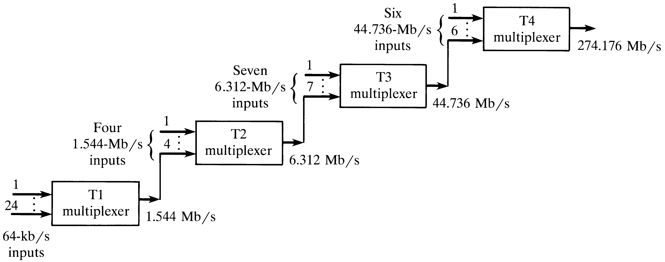
Digital transmission hierarchy
Notes:
1

Slide 2
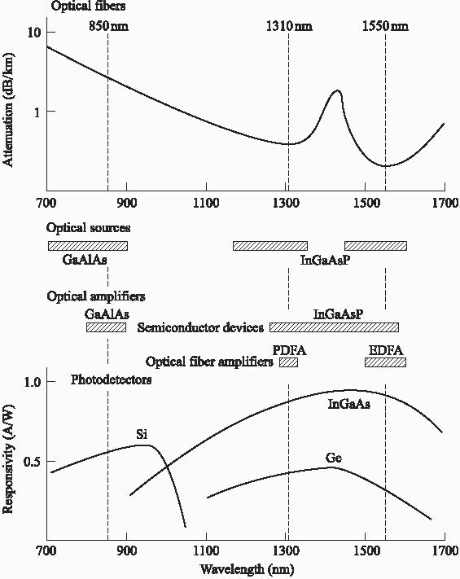
Operating ranges of components
Notes:
2

Slide 3
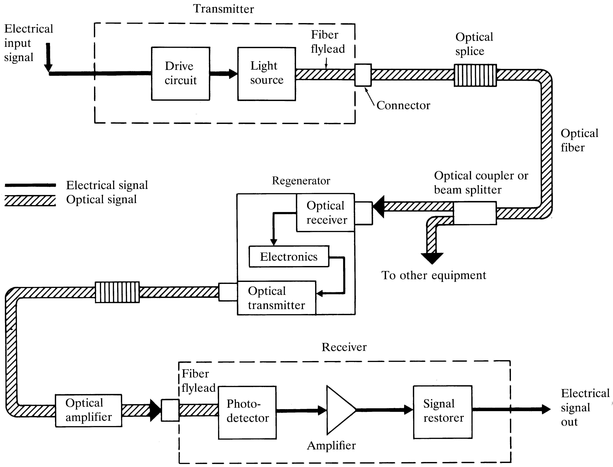
Major elements of an optical fiber link
Notes:
3

Slide 4
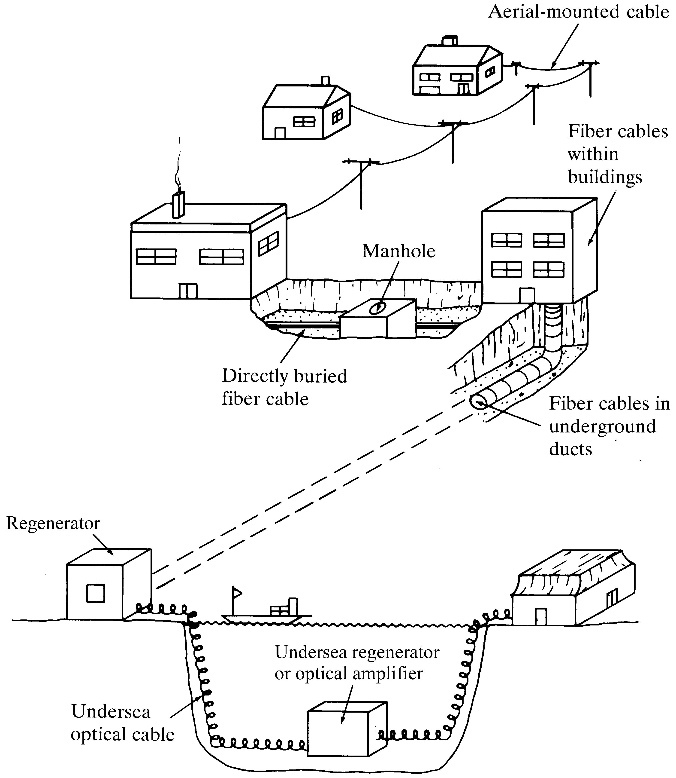
Optical fiber cable installations
Notes:
4

Slide 5
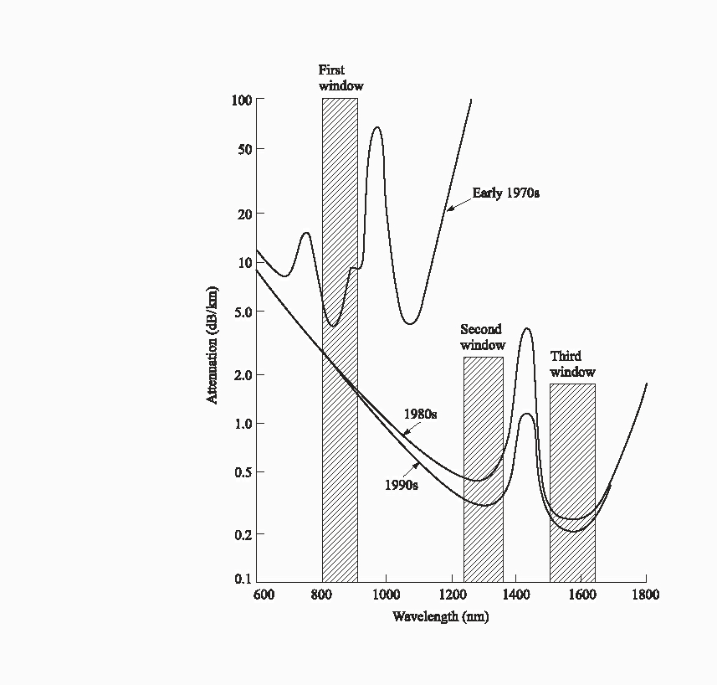
History of attenuation
Notes:
5

Slide 6
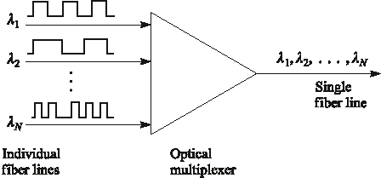
Optical multiplexing
Notes:
6

Slide 7
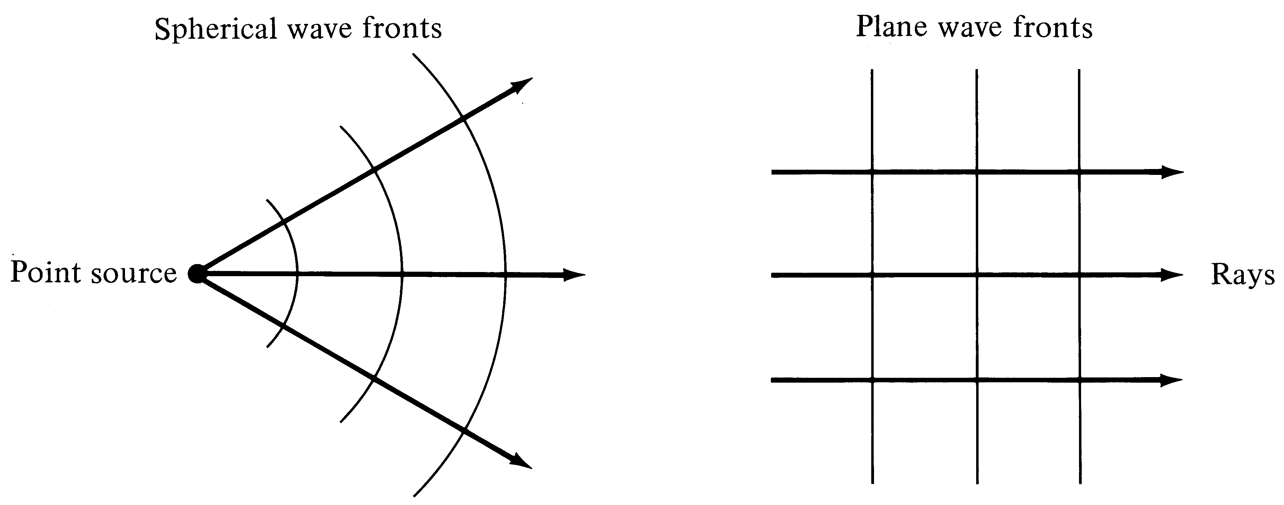
Spherical and plane wave fronts
Notes:
1

Slide 8
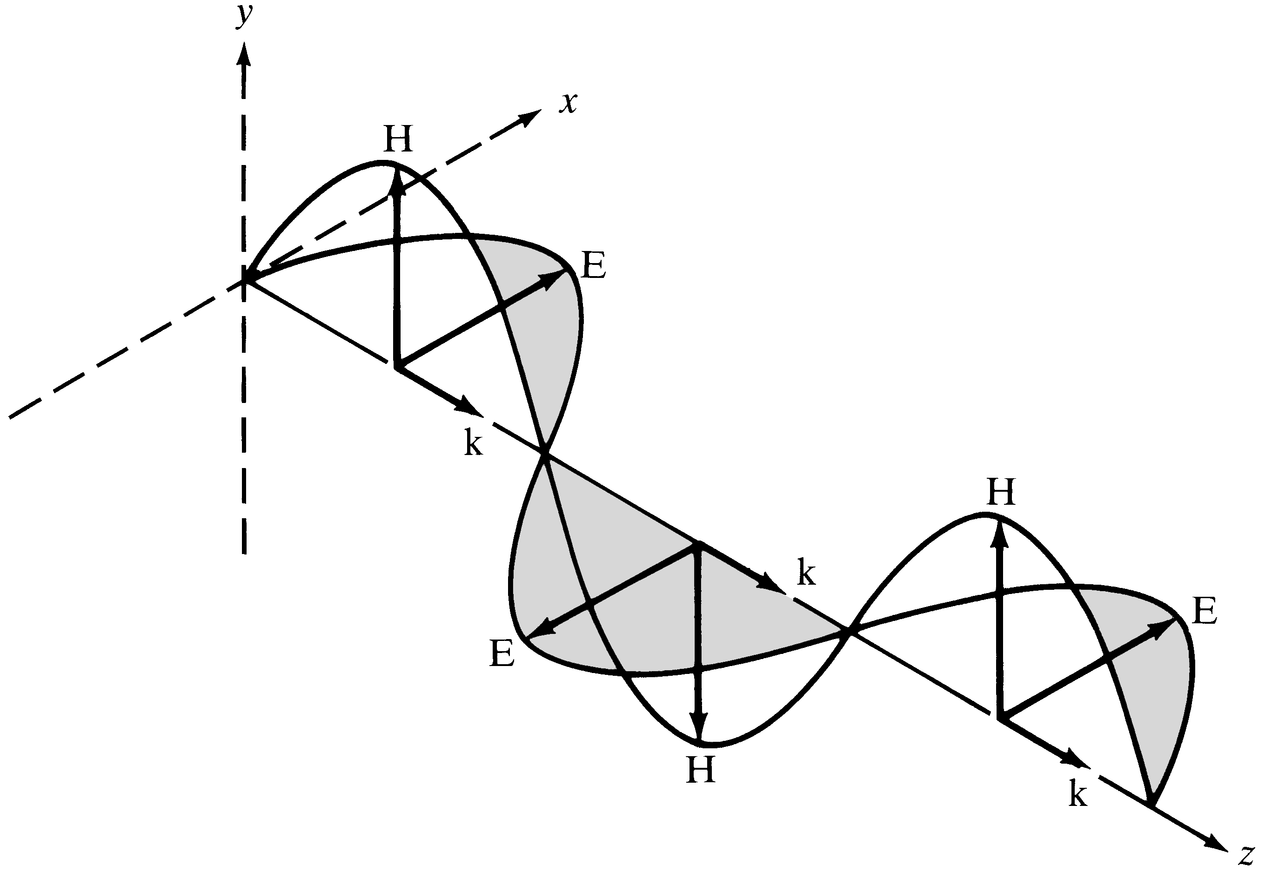
Field distributions in plane E&M waves
Notes:
2

Slide 9
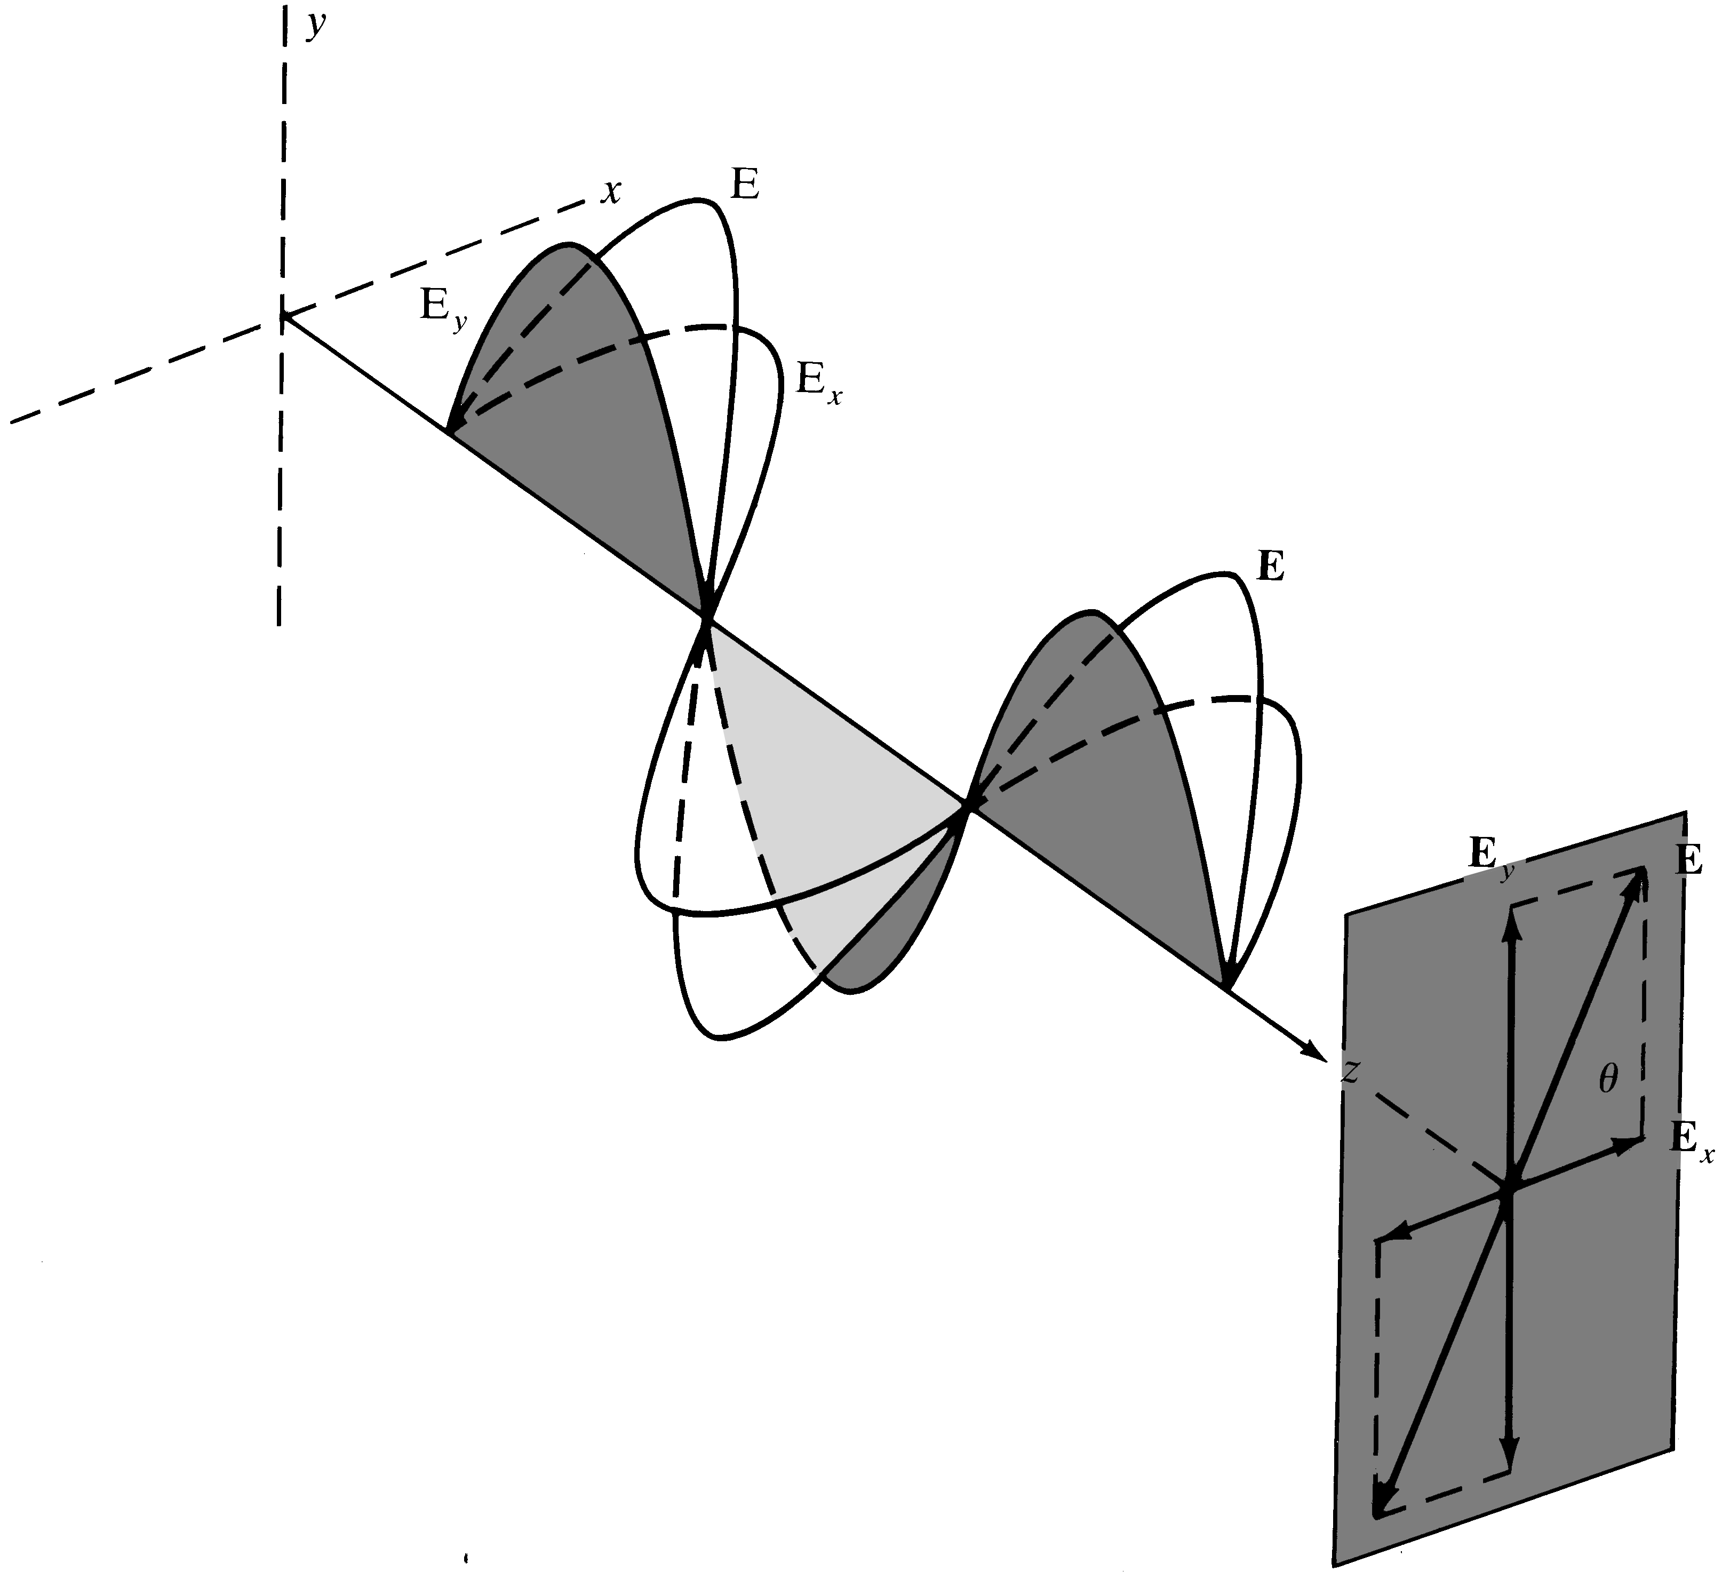
Adding two linearly polarized waves
Notes:
3

Slide 10
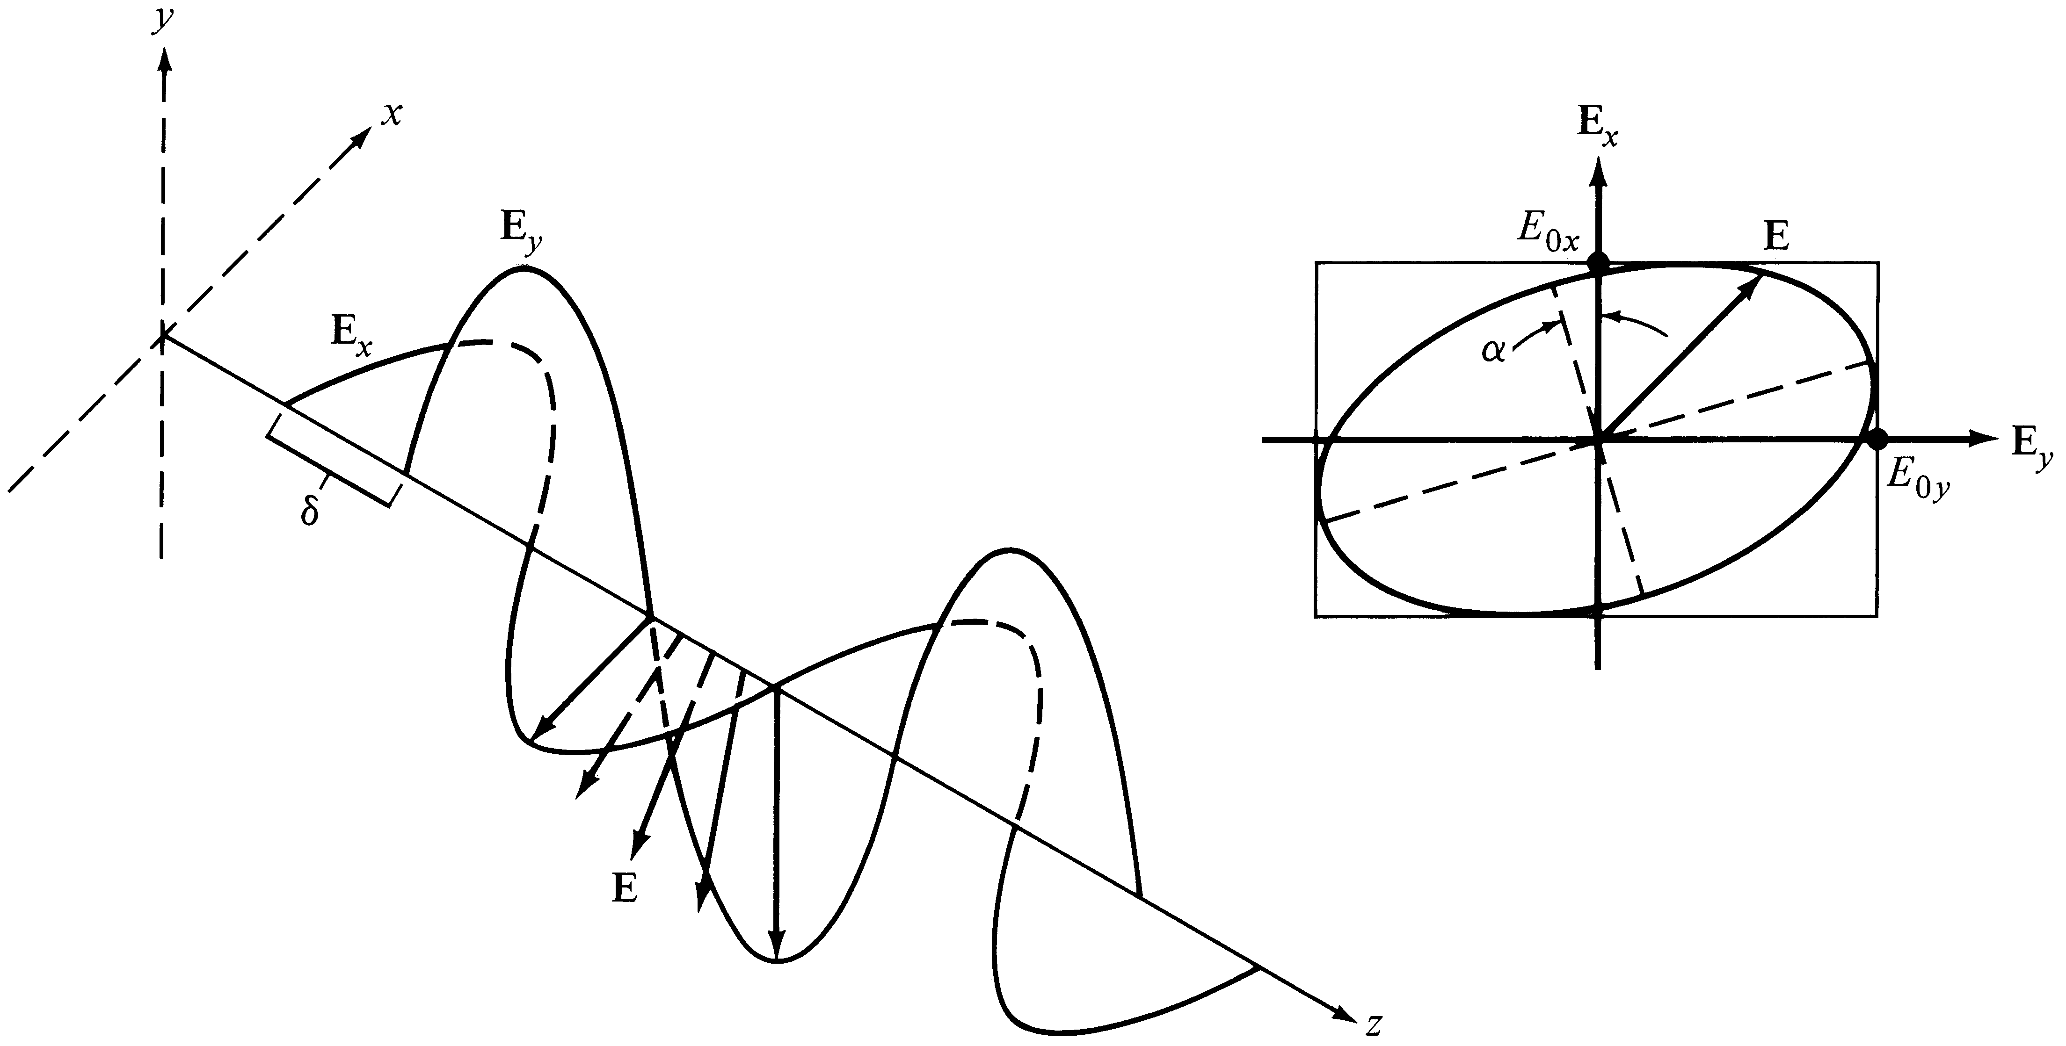
Elliptically polarized light
Notes:
4

Slide 11
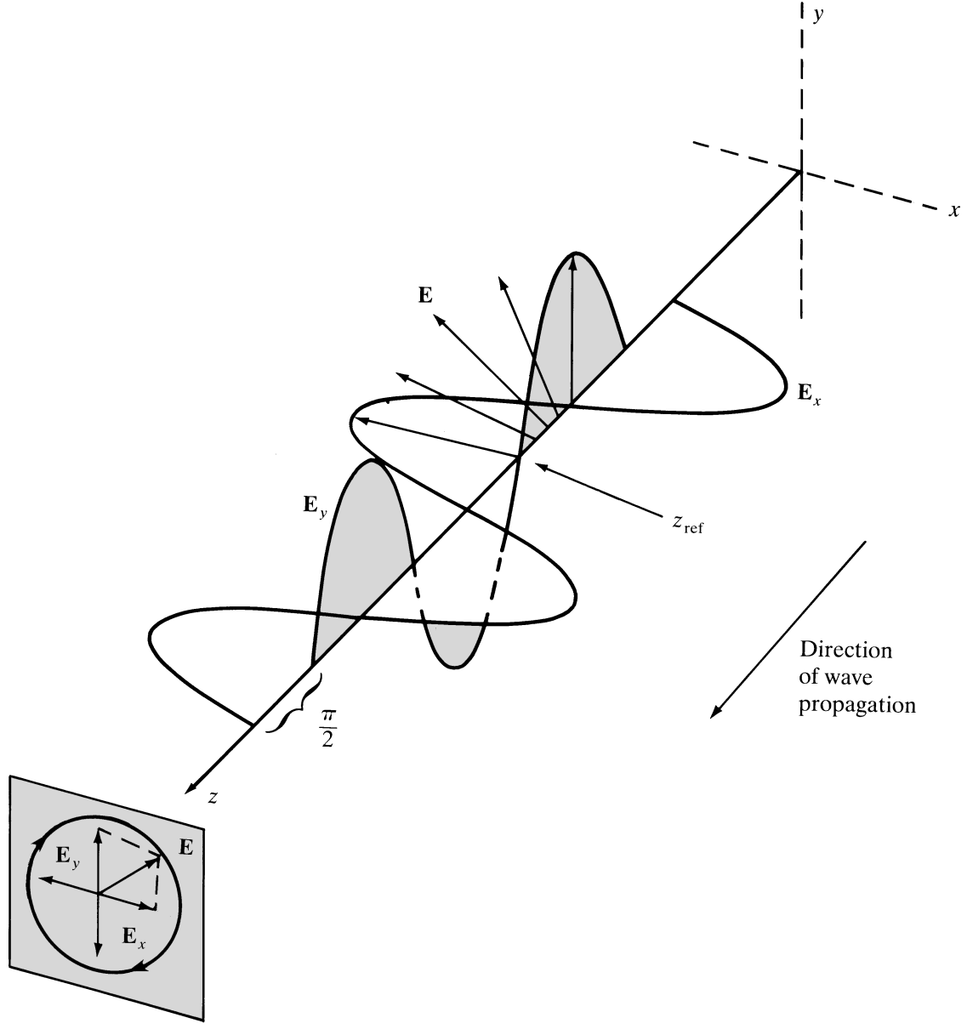
Adding linearly polarized waves
Notes:
5

Slide 12
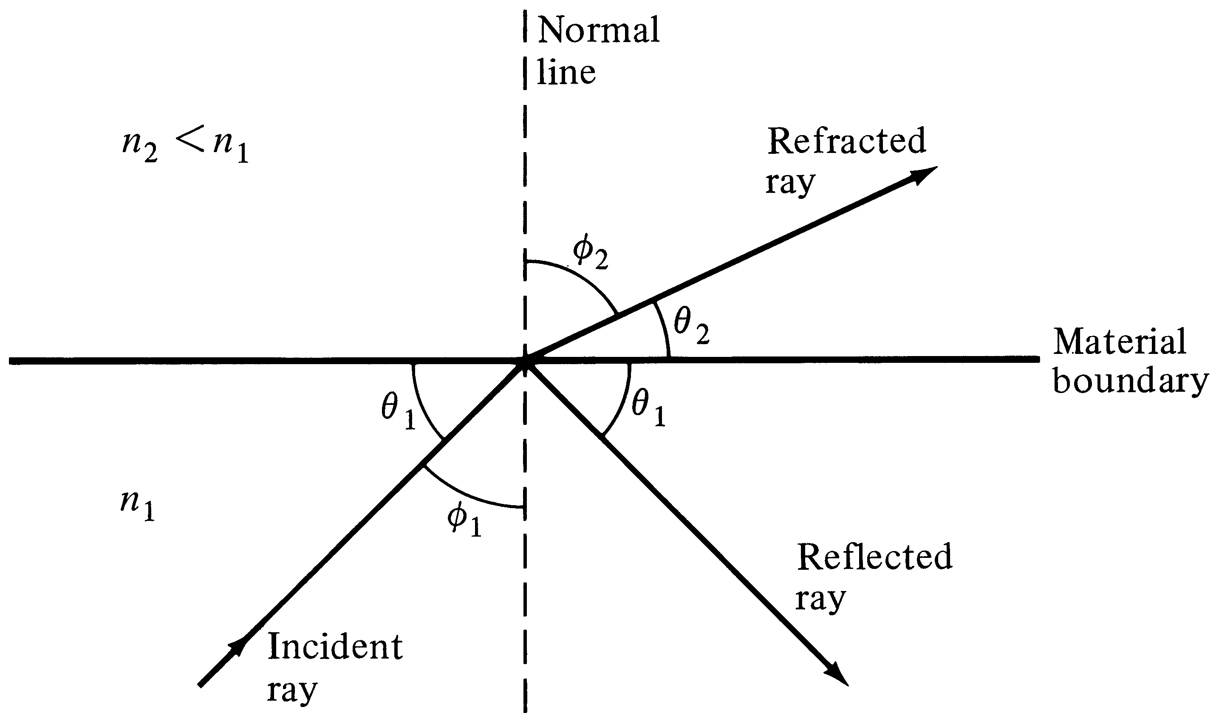
Refraction and reflection
Notes:
6

Slide 13
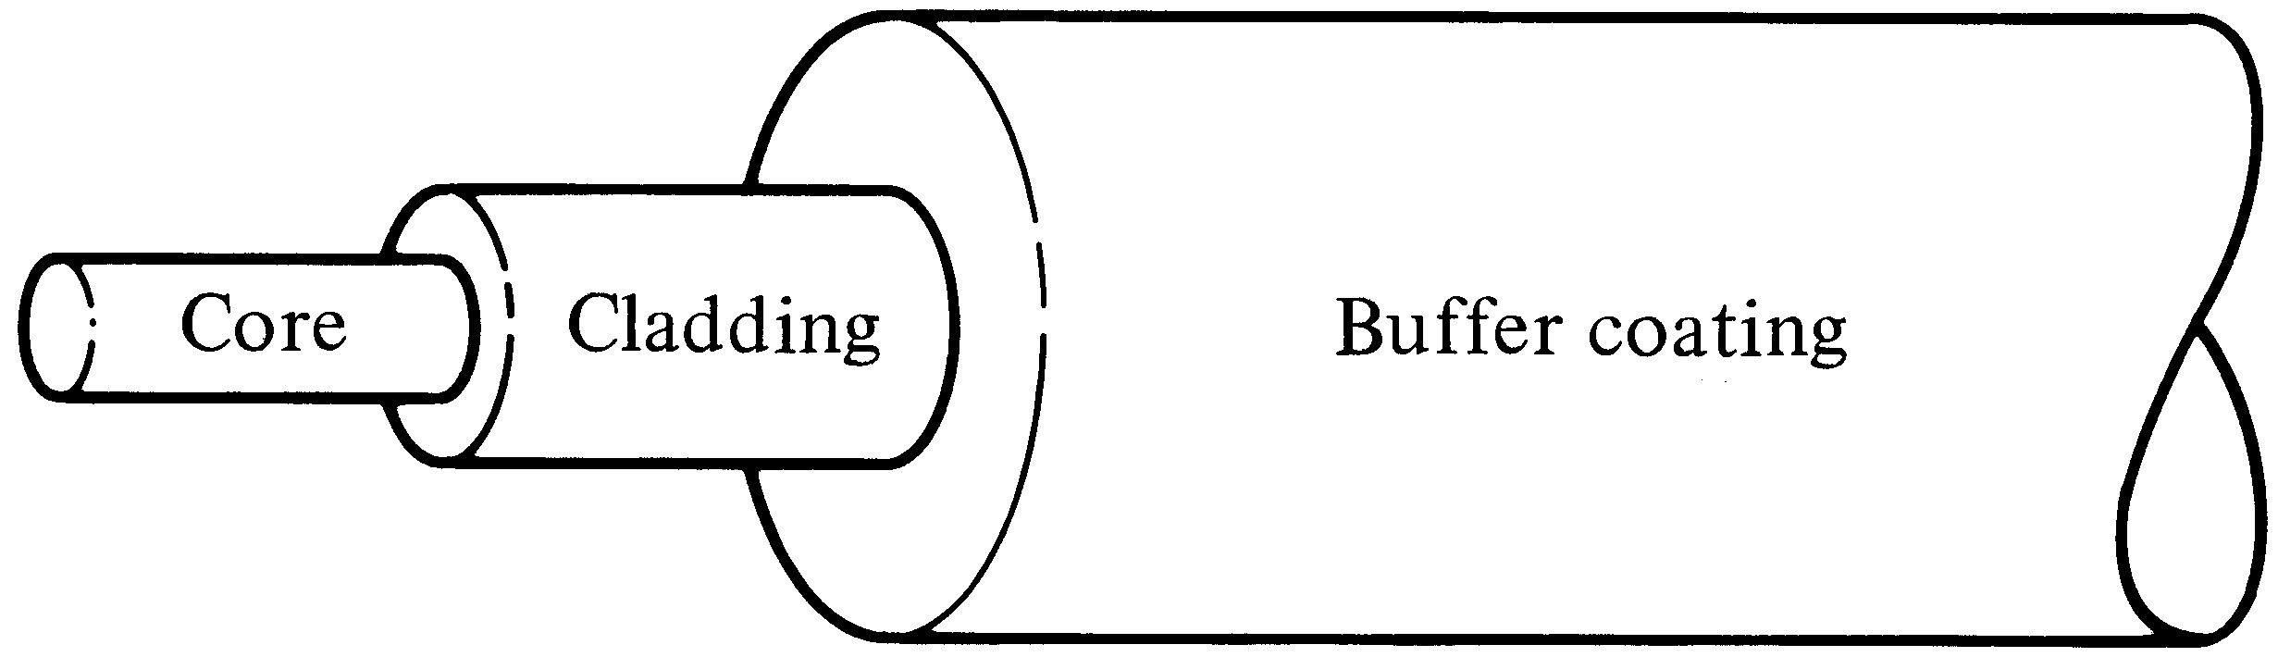
Single fiber structure
Notes:
7

Slide 14
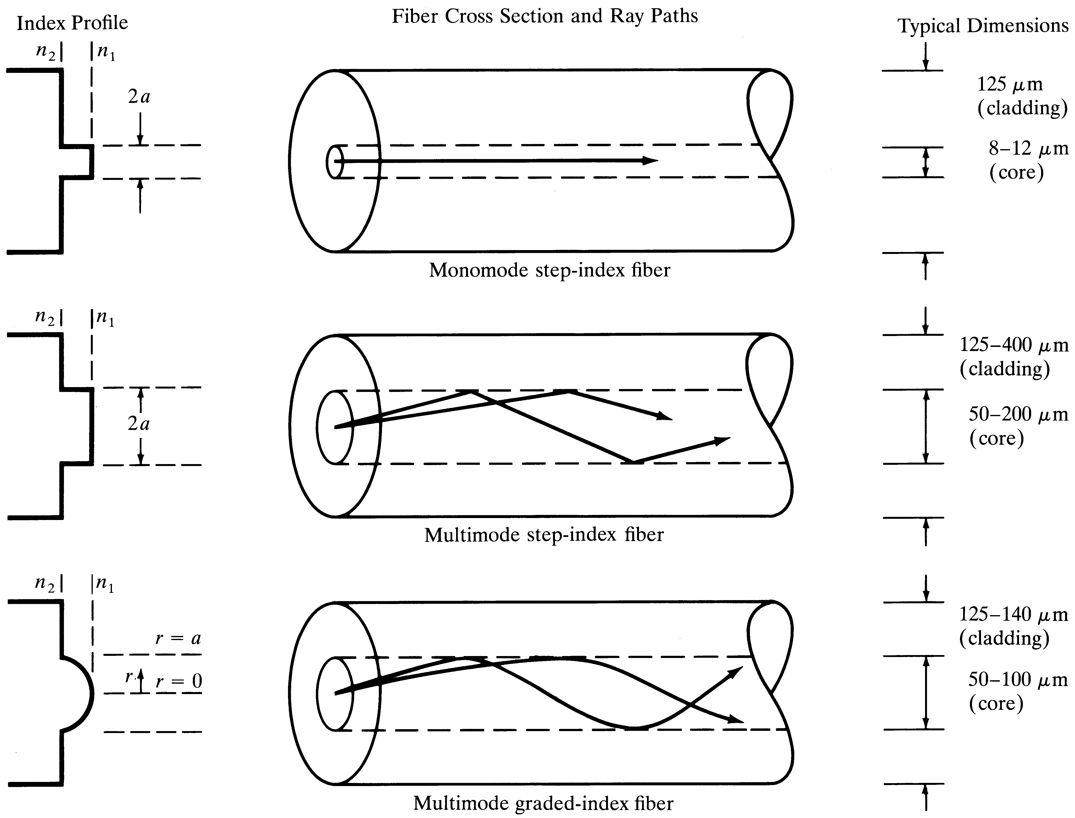
Comparison of fiber structures

Slide 15
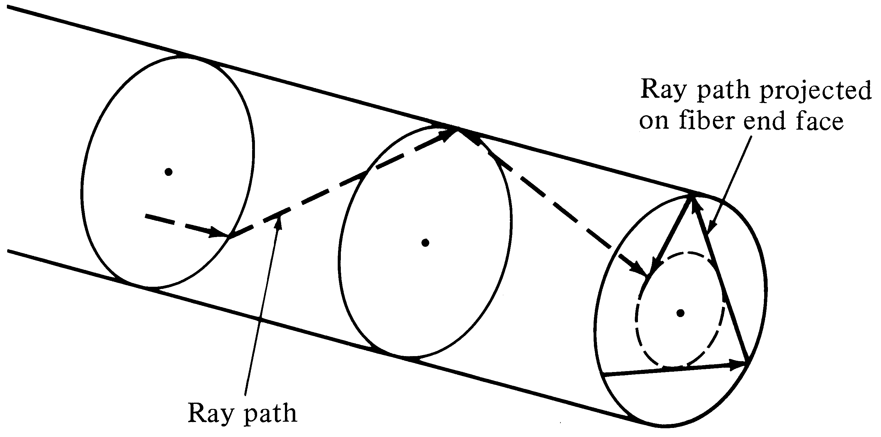
Skew rays

Slide 16
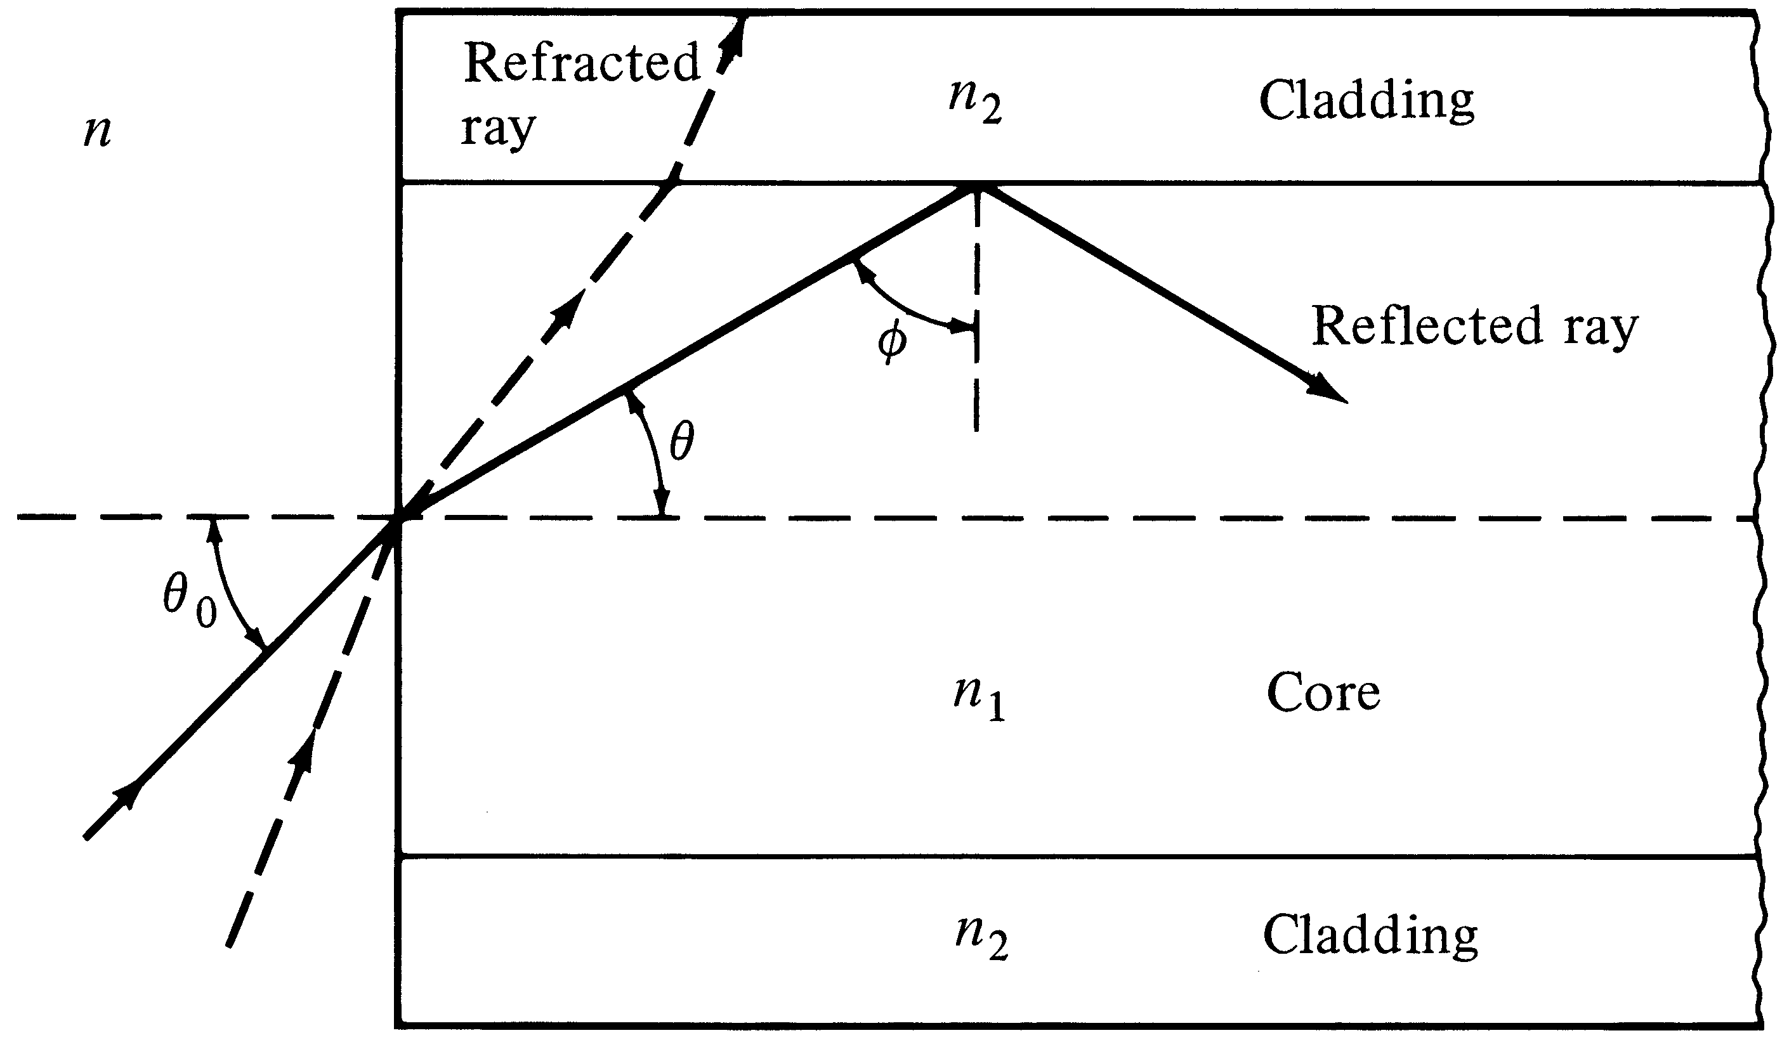
Meridional ray representation

Slide 17
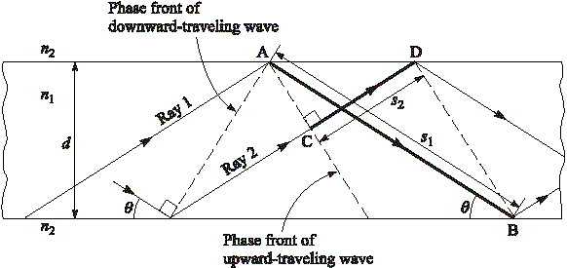
Fig. 2-13: Light propagation

Slide 18
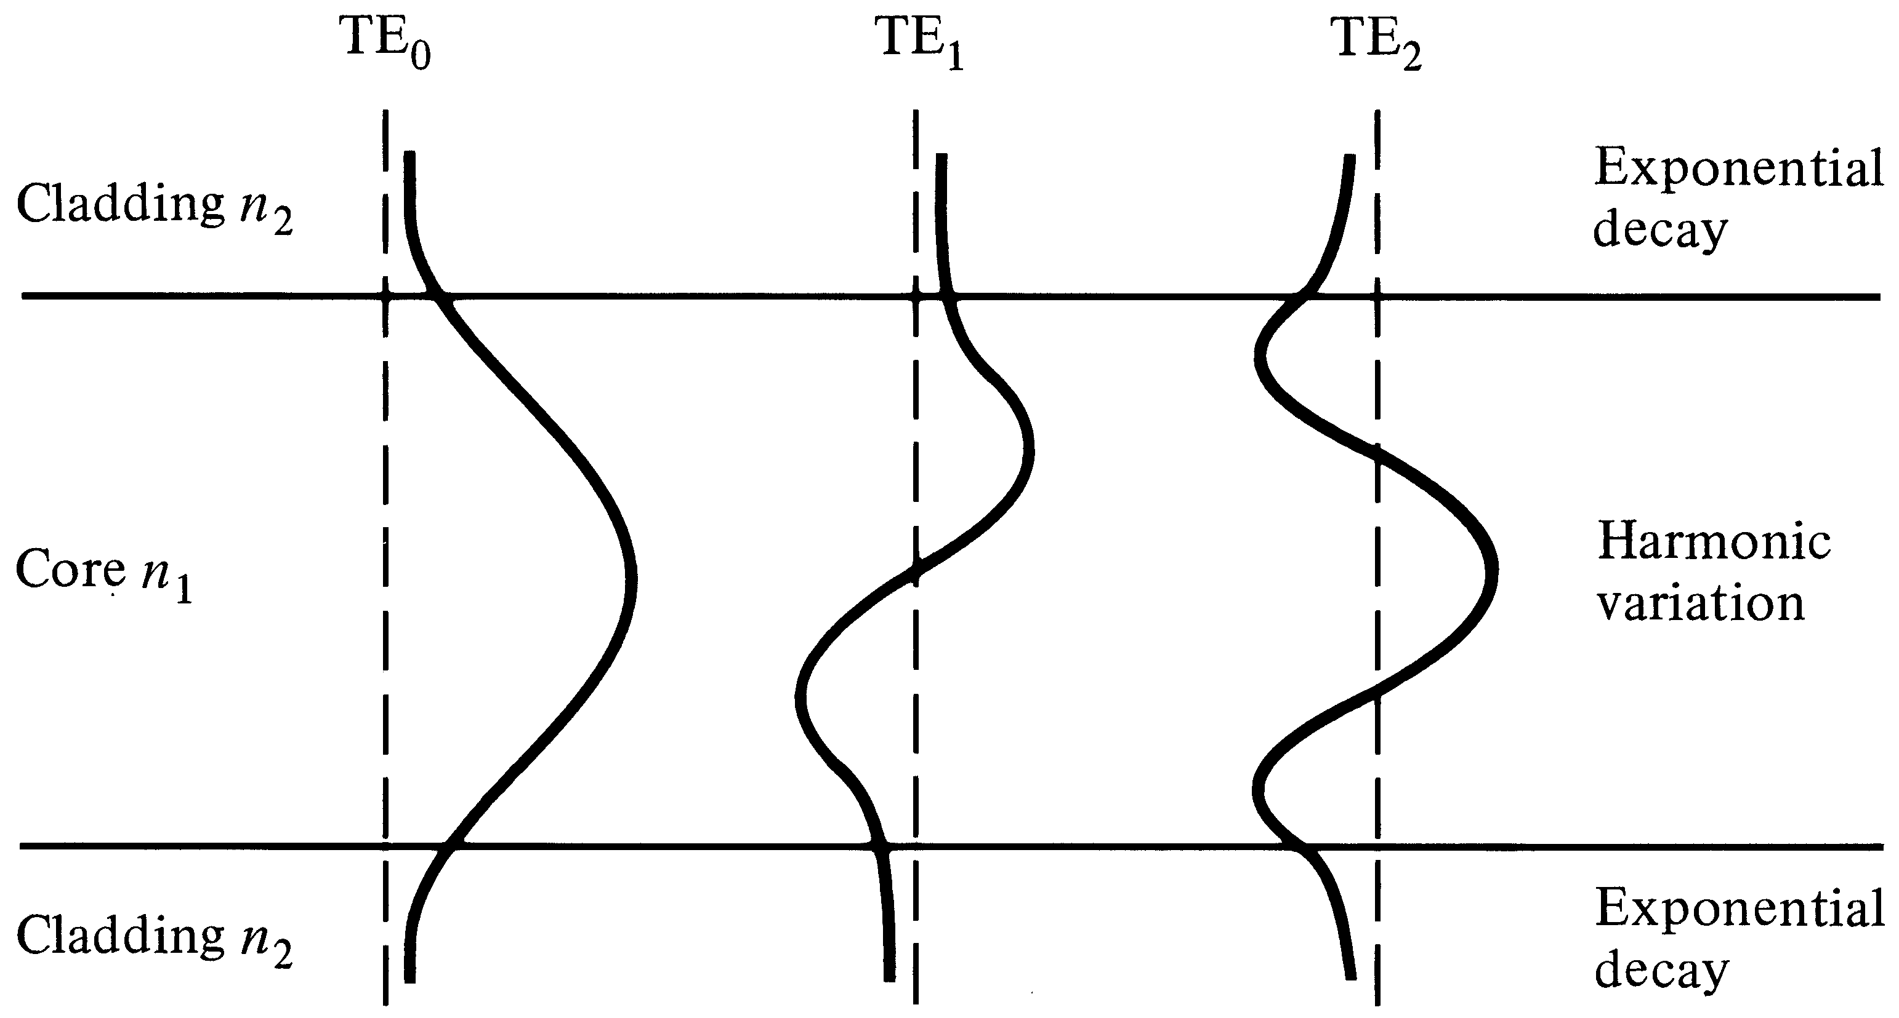
Low-order-mode fields

Slide 19
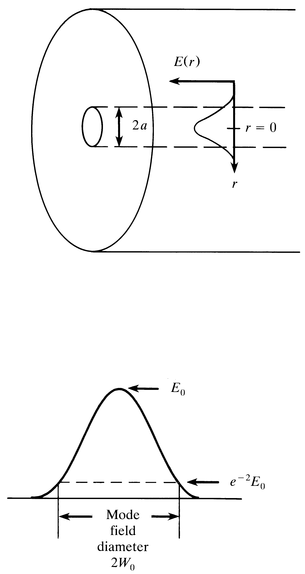
Mode-field diameter

Slide 20
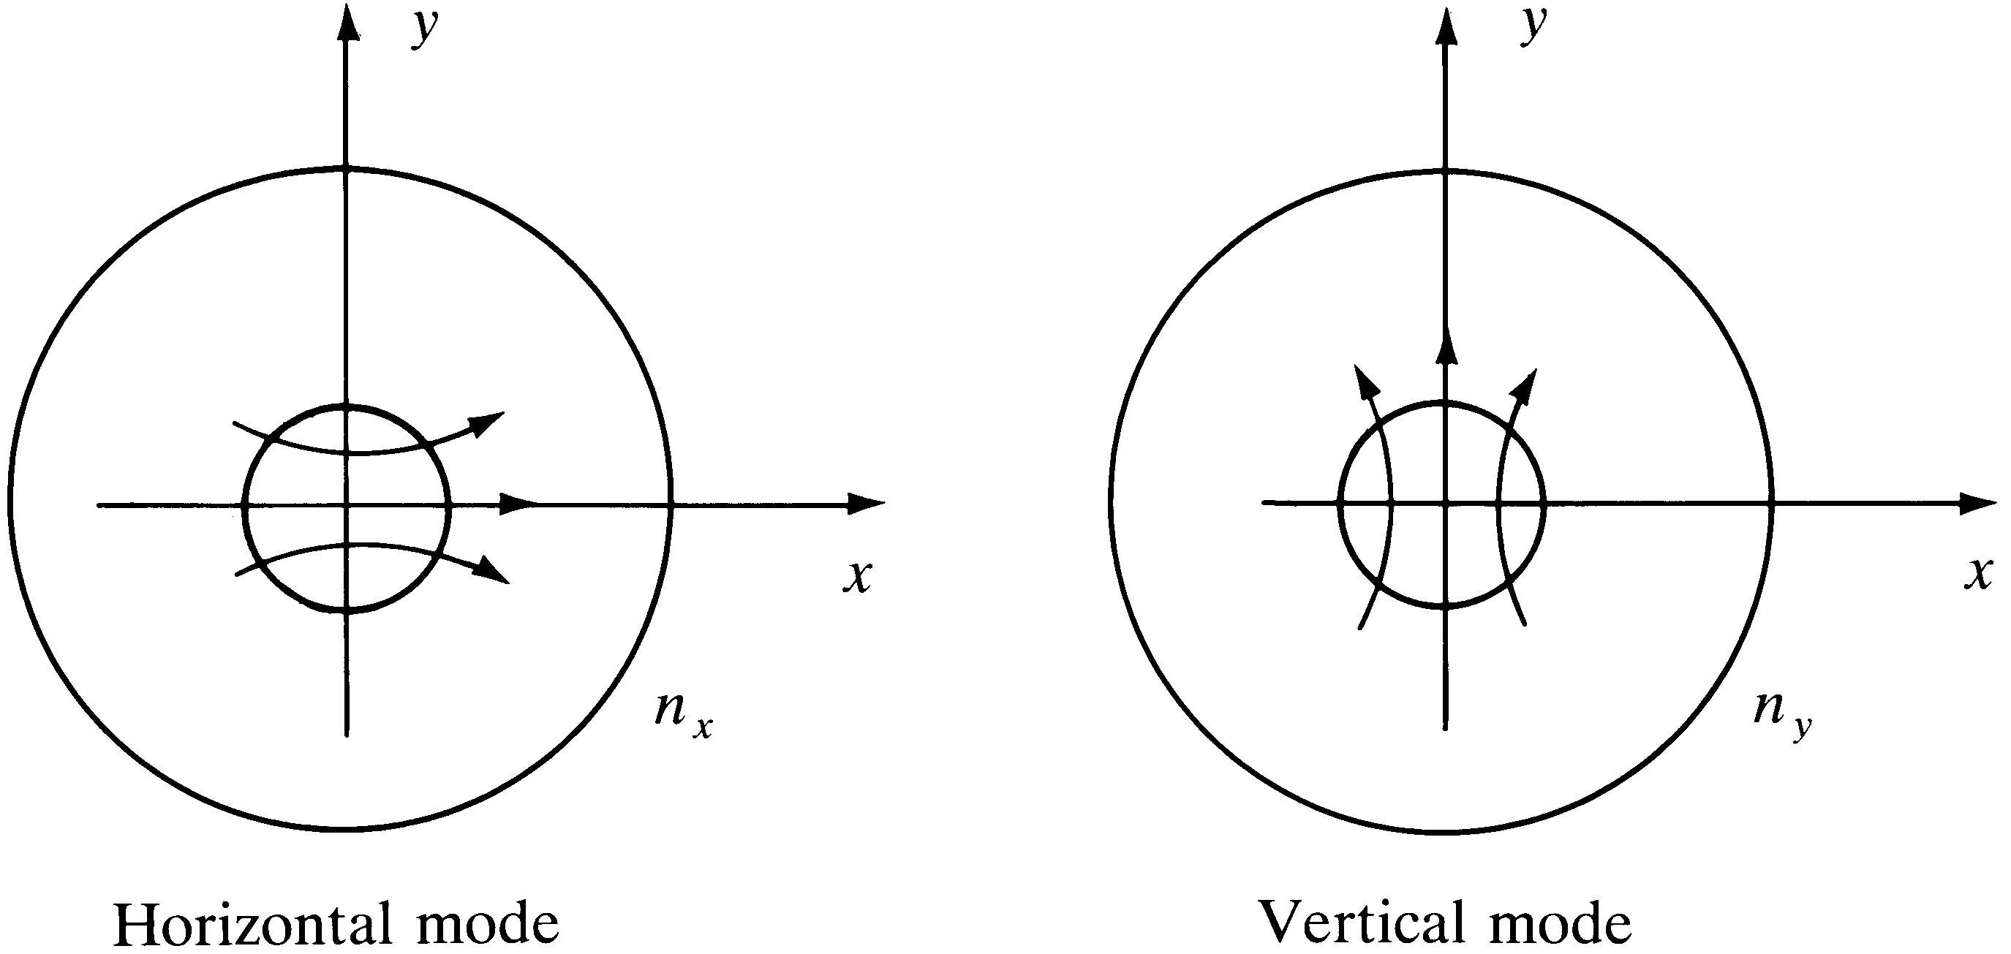
Polarizations of fundamental mode

Slide 21
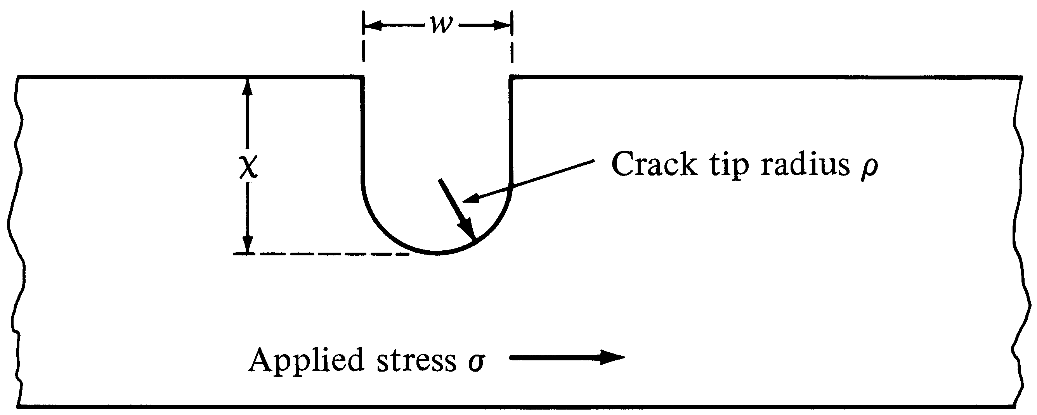
Microcrack model

Slide 22
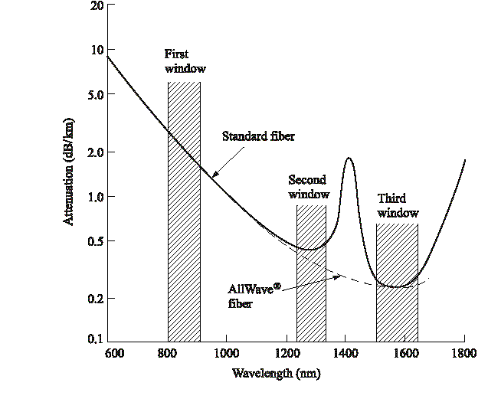
Optical fiber attenuation
Notes:
1

Slide 23
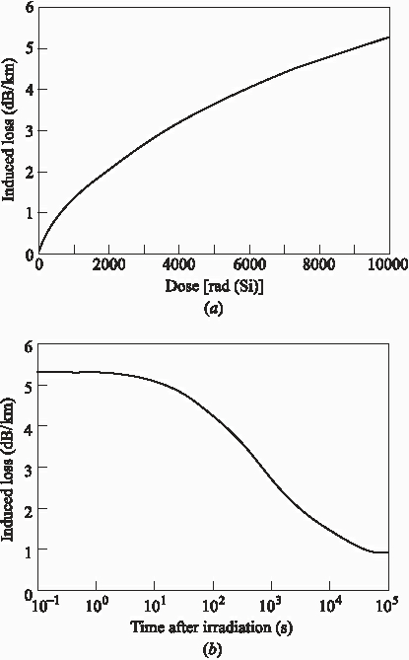
Effects of ionizing radiation
Notes:
2

Slide 24
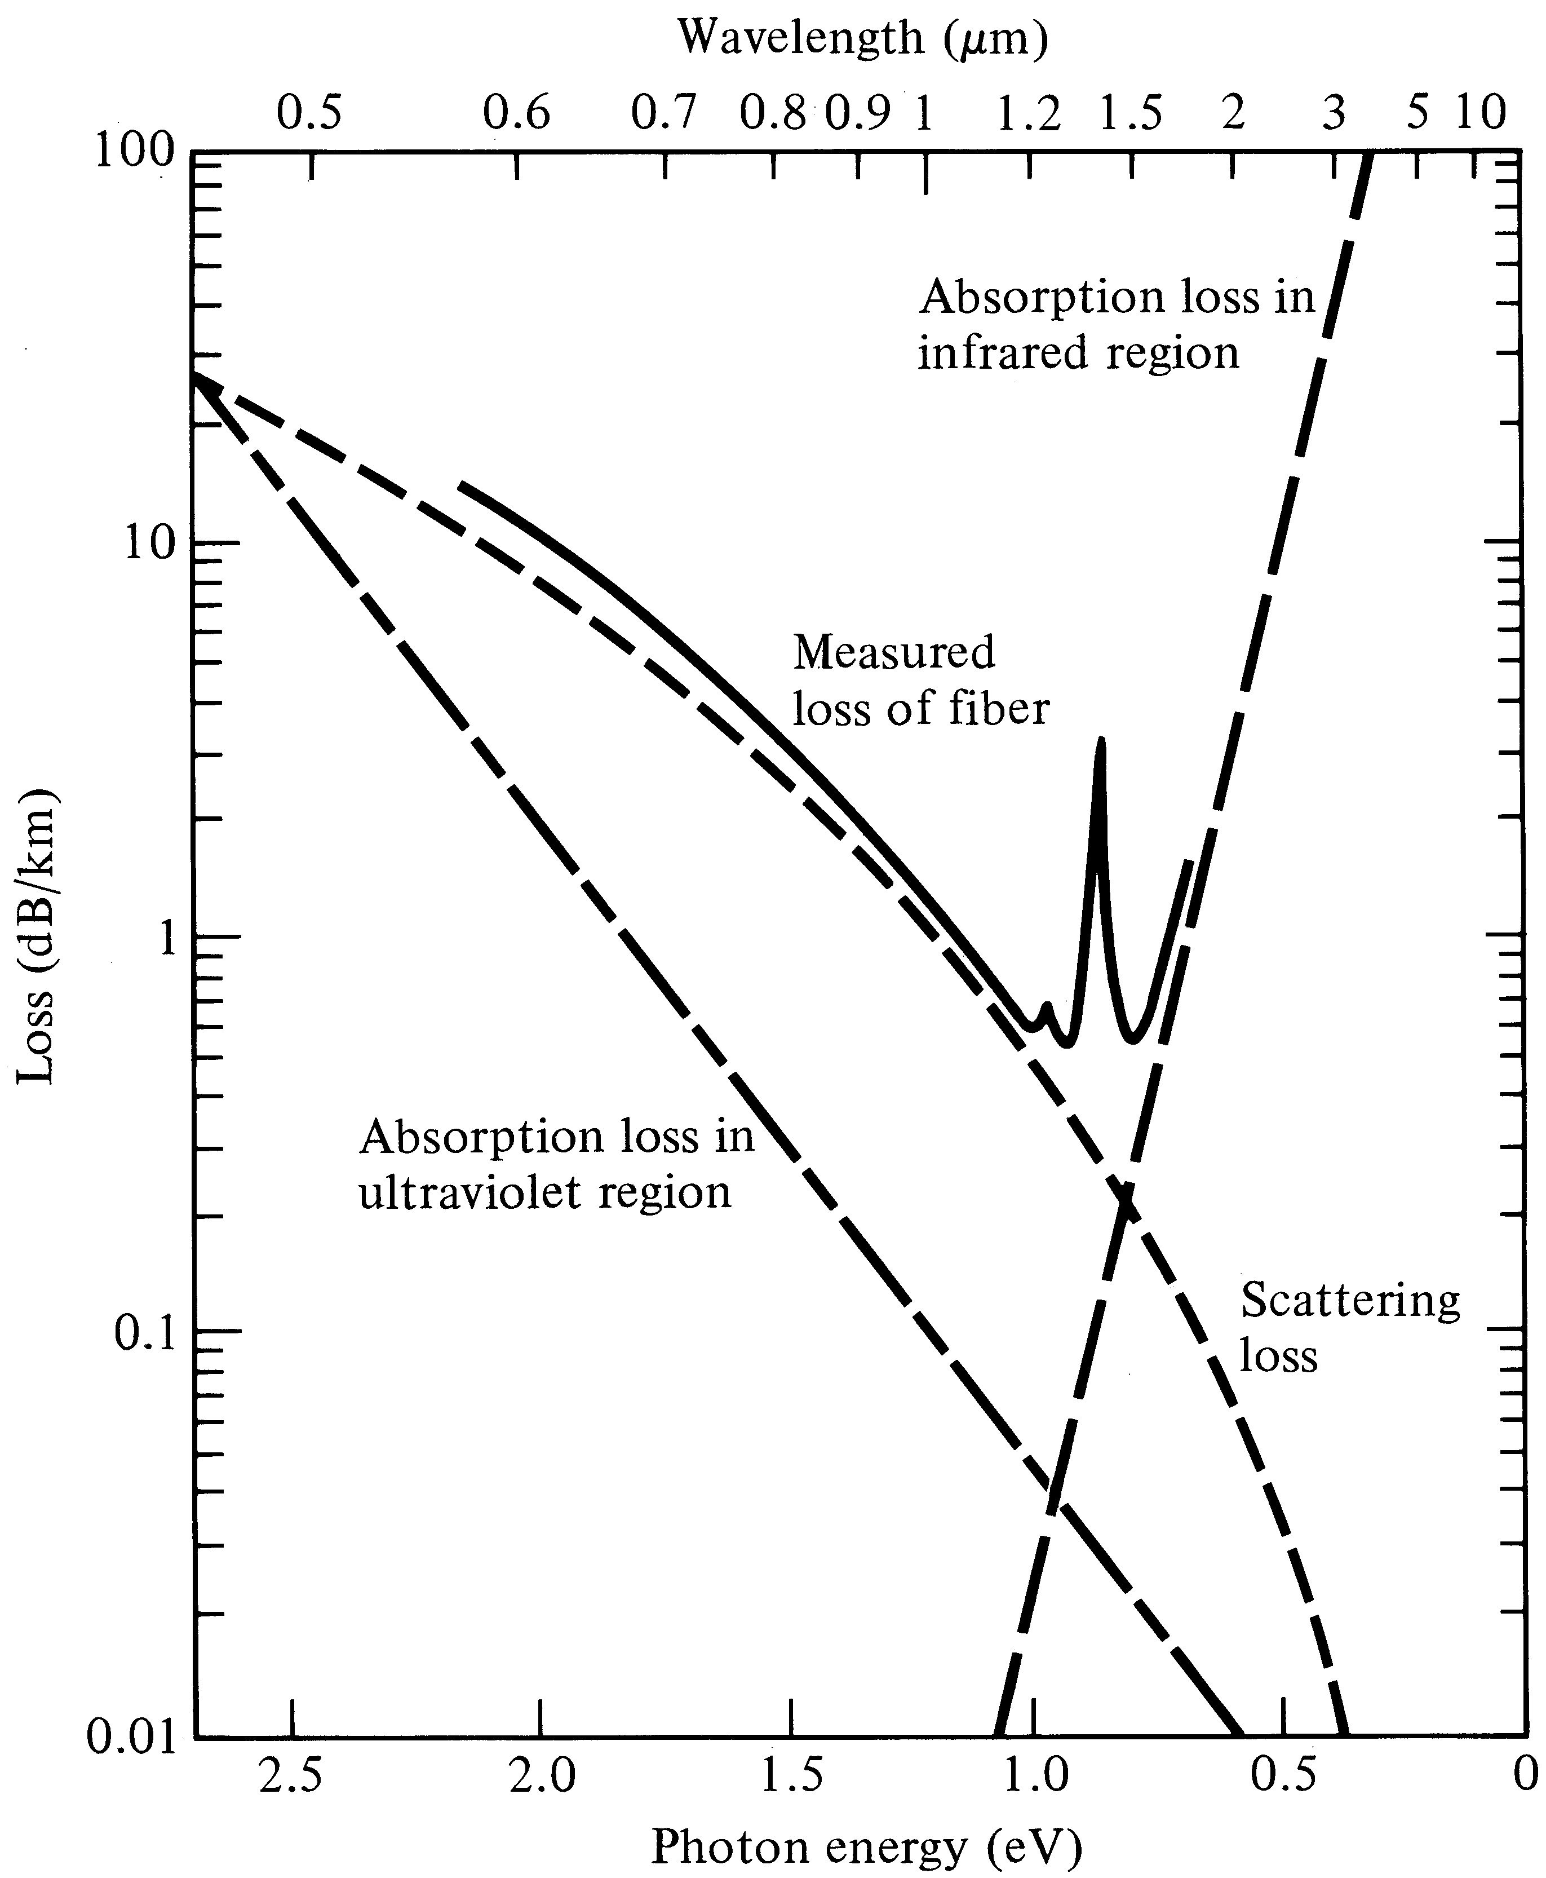
Attenuation characteristics
Notes:
3

Slide 25
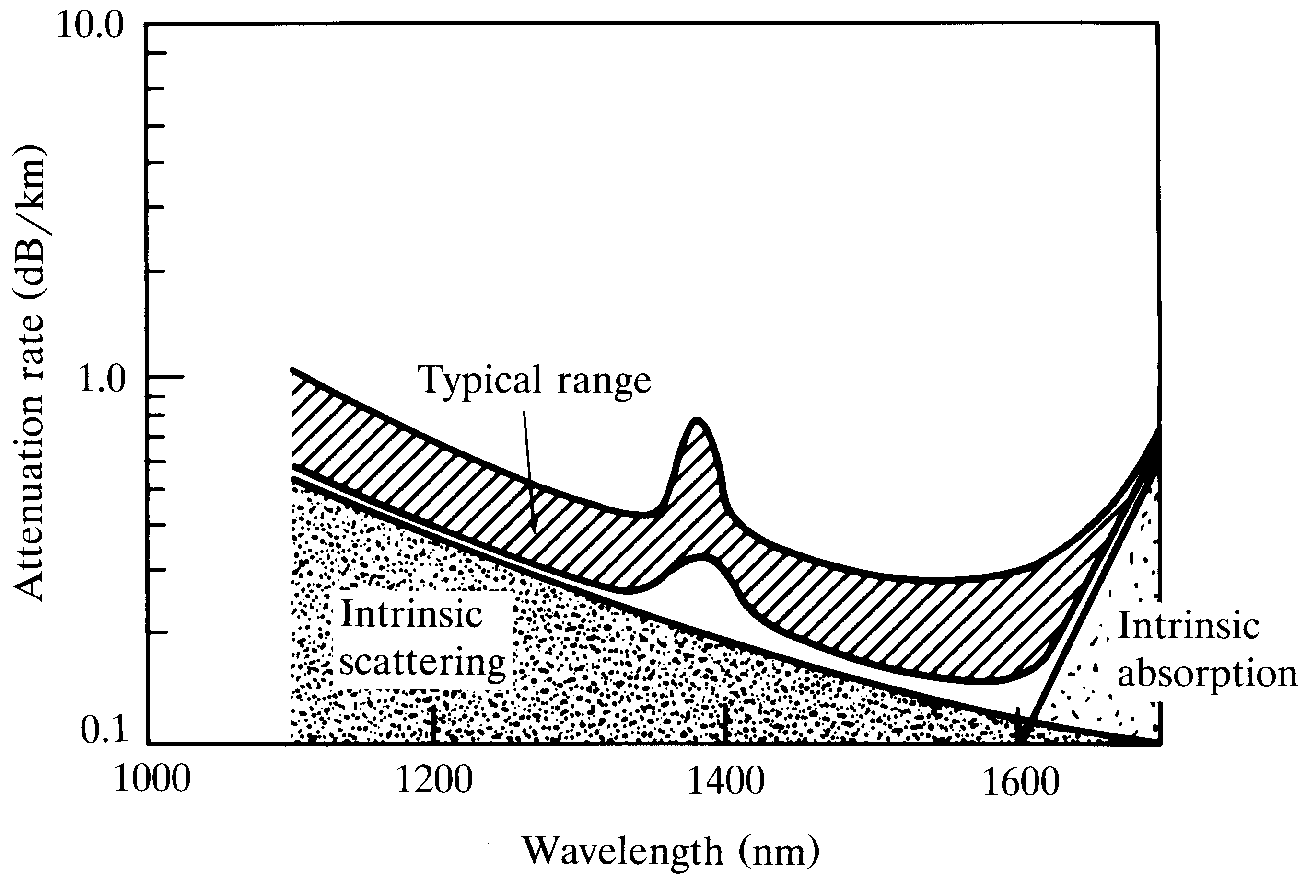
Single-mode fiber attenuation
Notes:
4

Slide 26
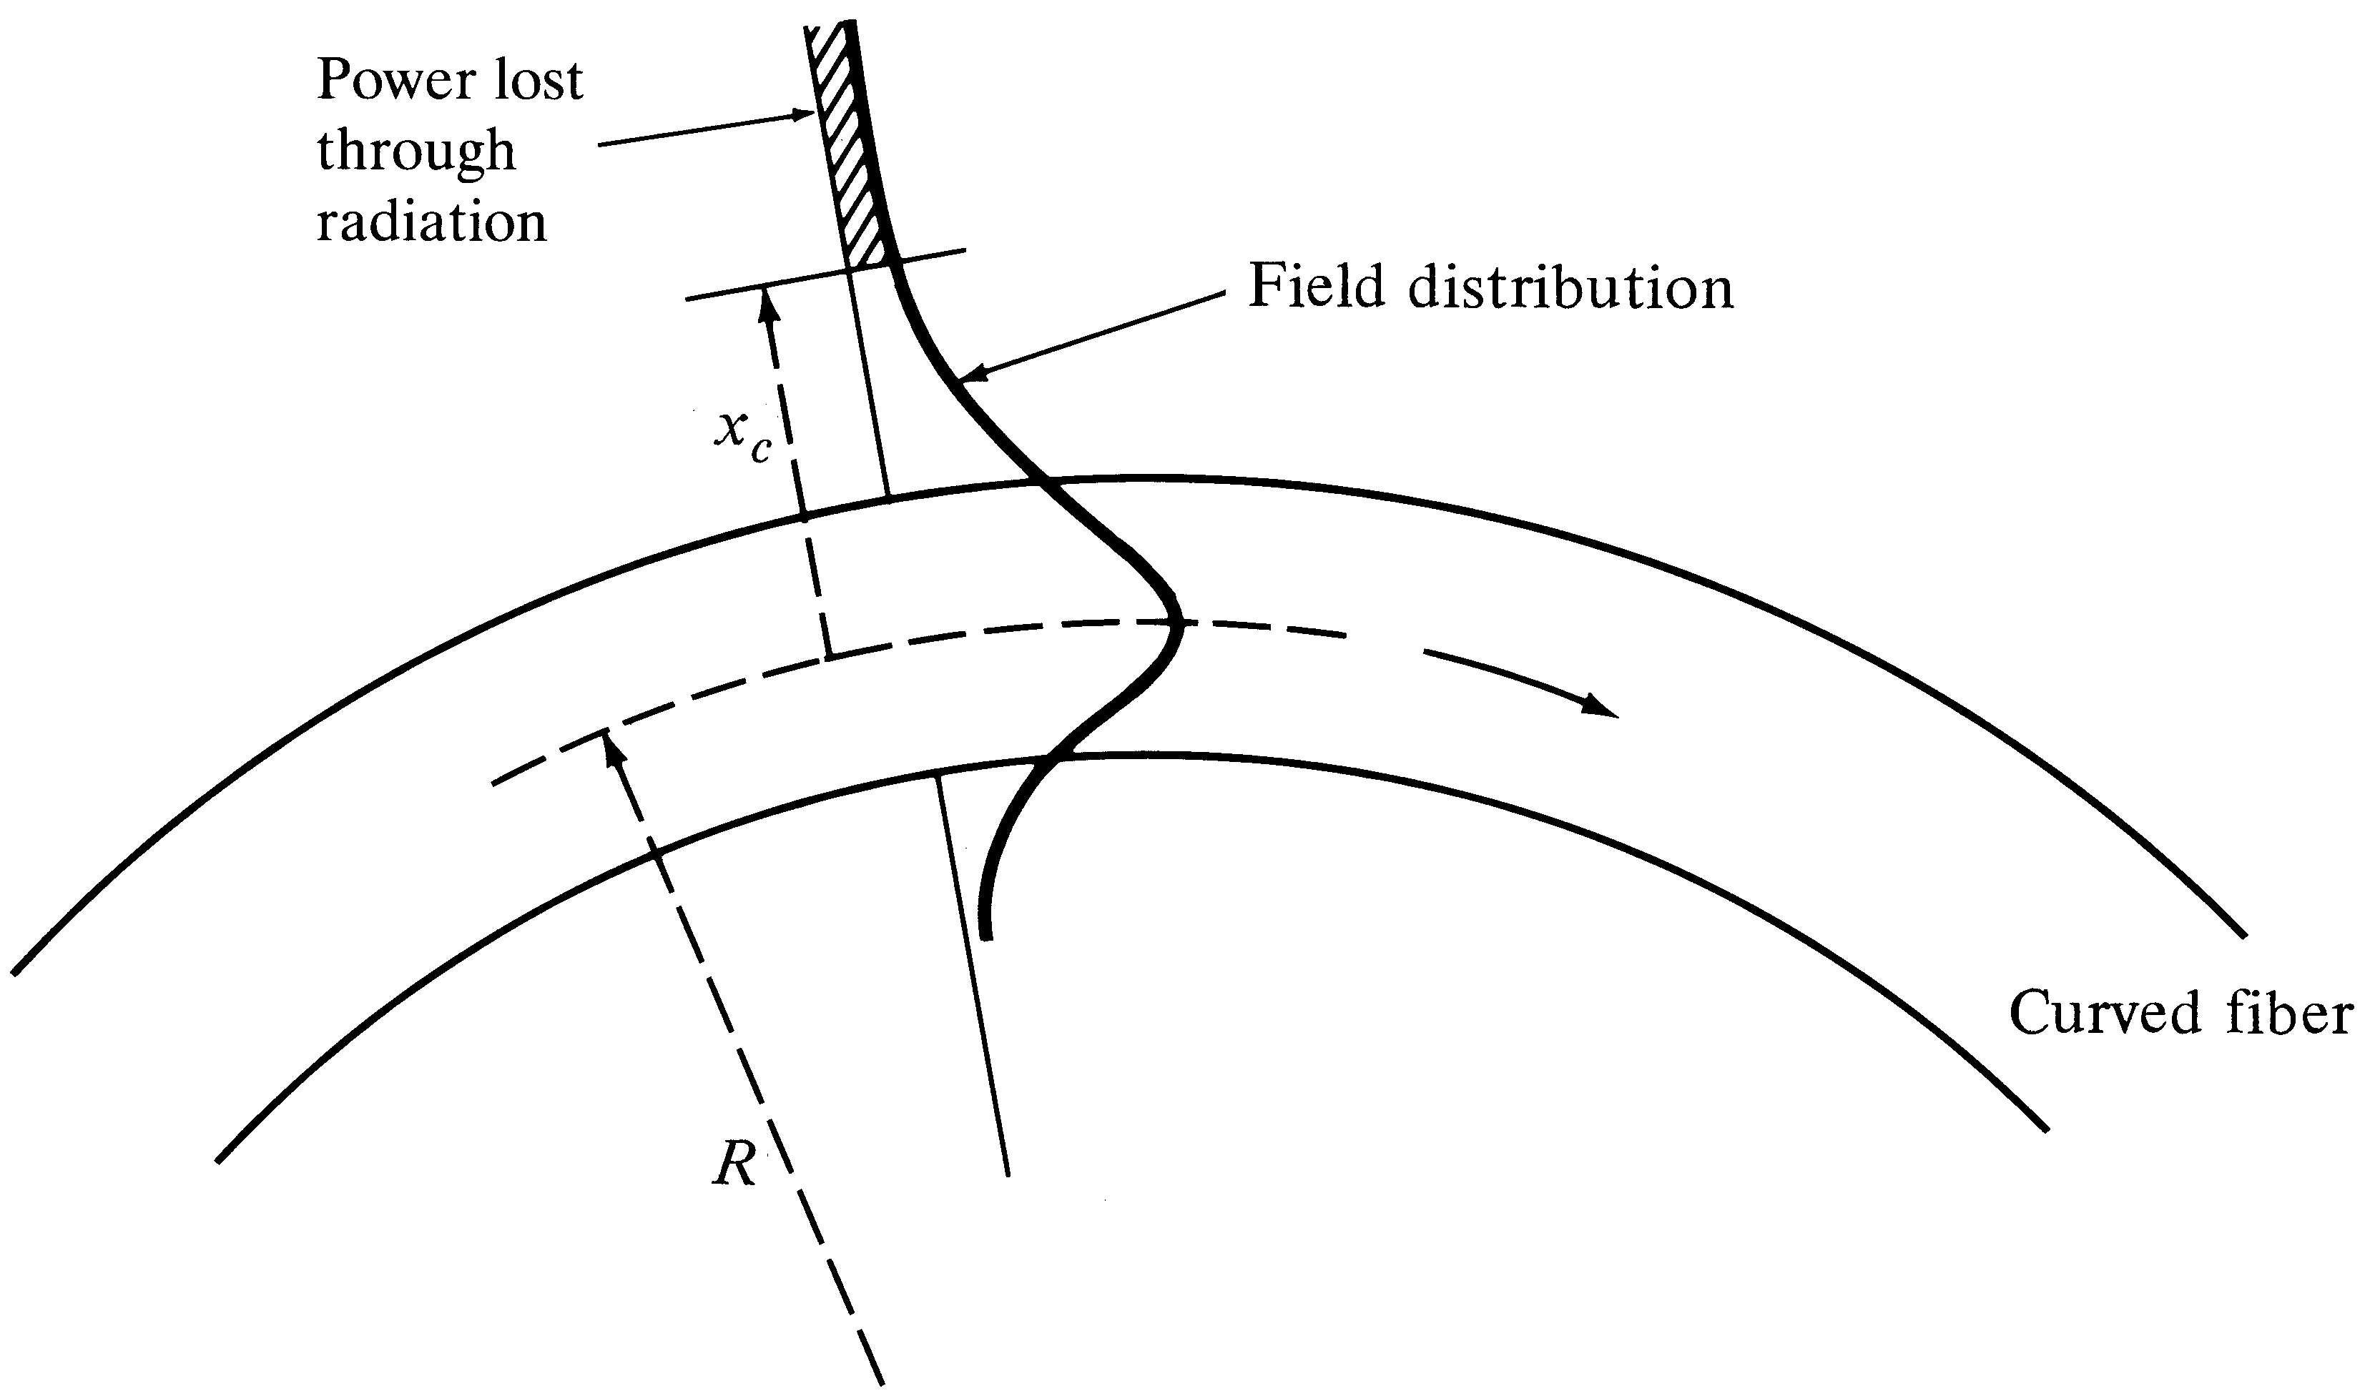
Power loss in a curved fiber
Notes:
5

Slide 27
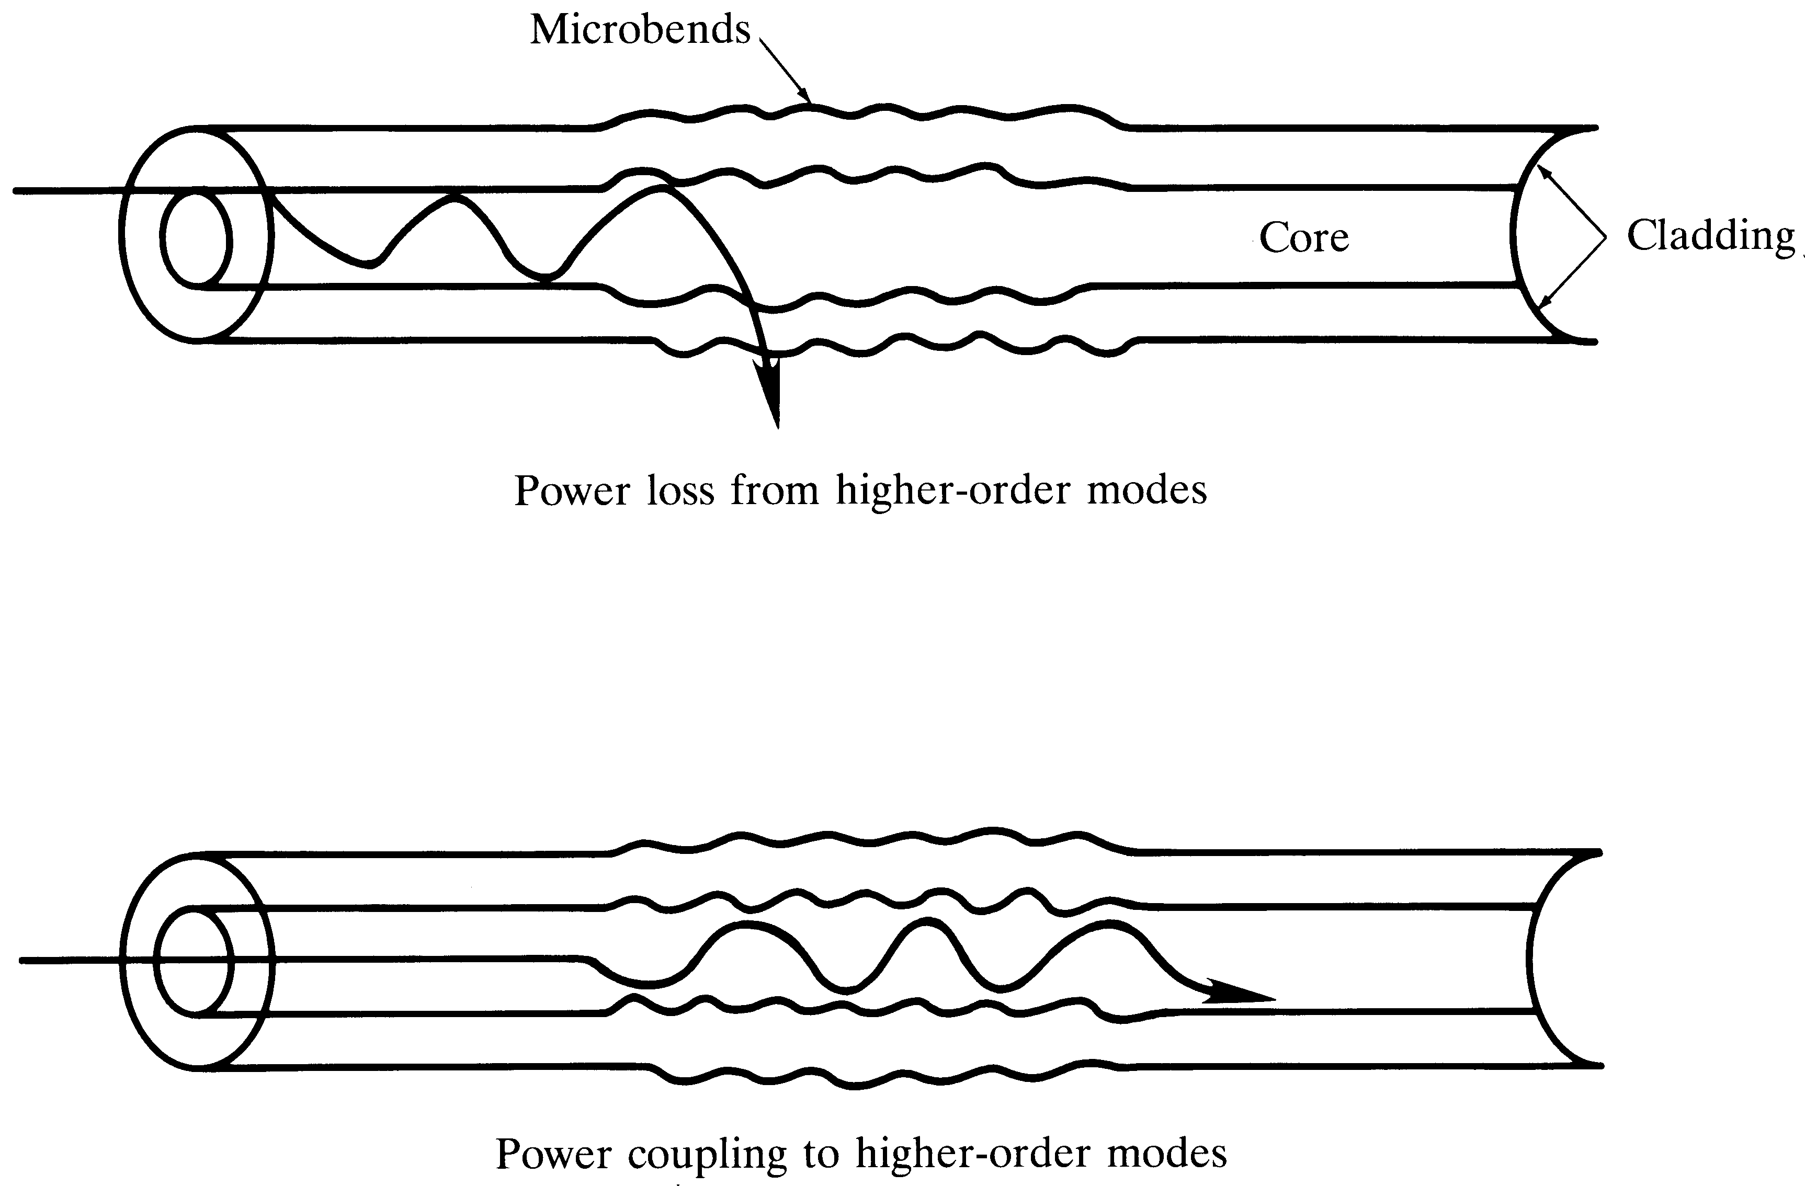
Microbending losses
Notes:
6

Slide 28
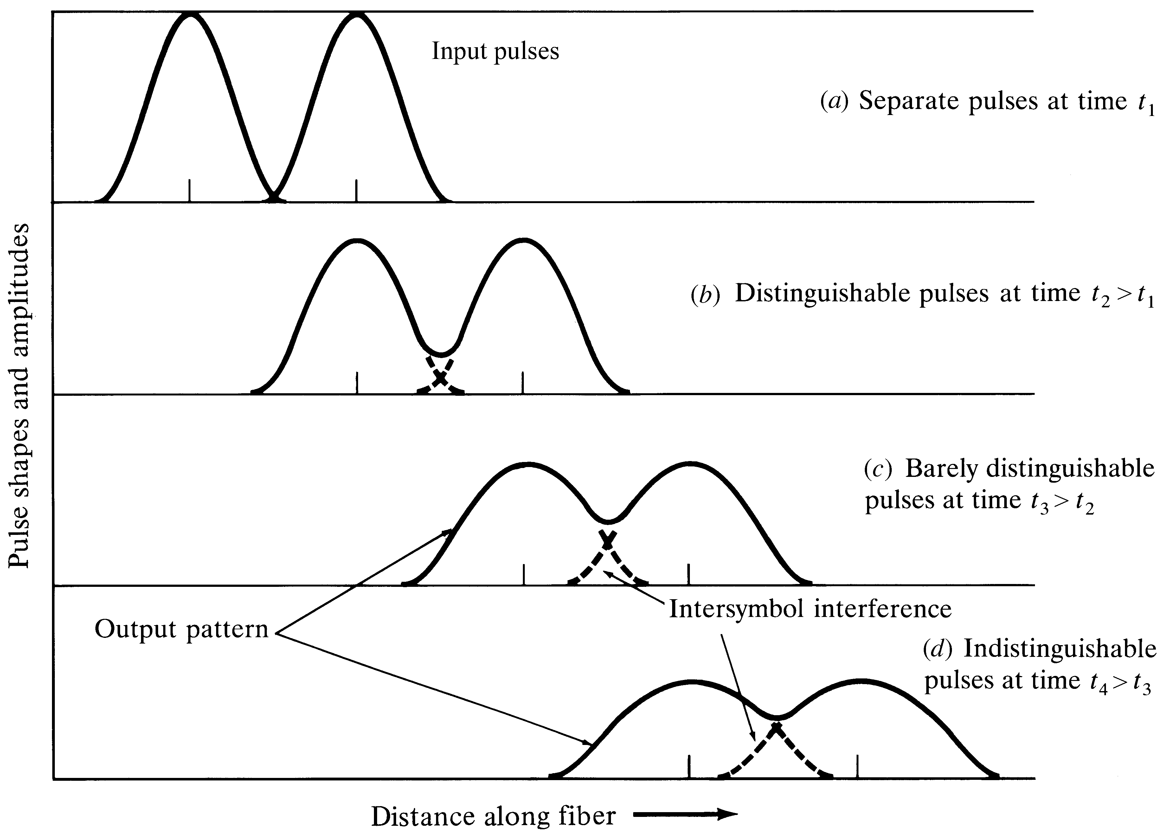
Pulse broadening and attenuation
Notes:
7

Slide 29
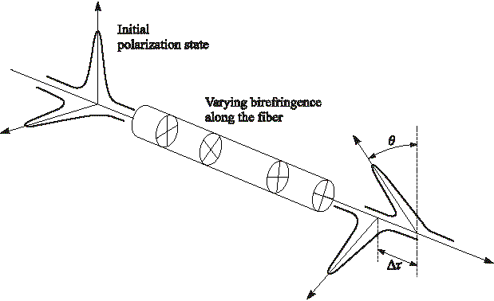
Polarization mode dispersion
Notes:
8

Slide 30
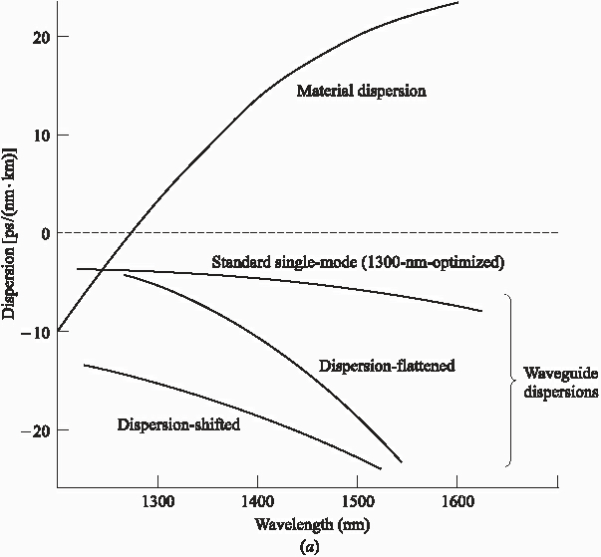
SM-fiber dispersions

Slide 31
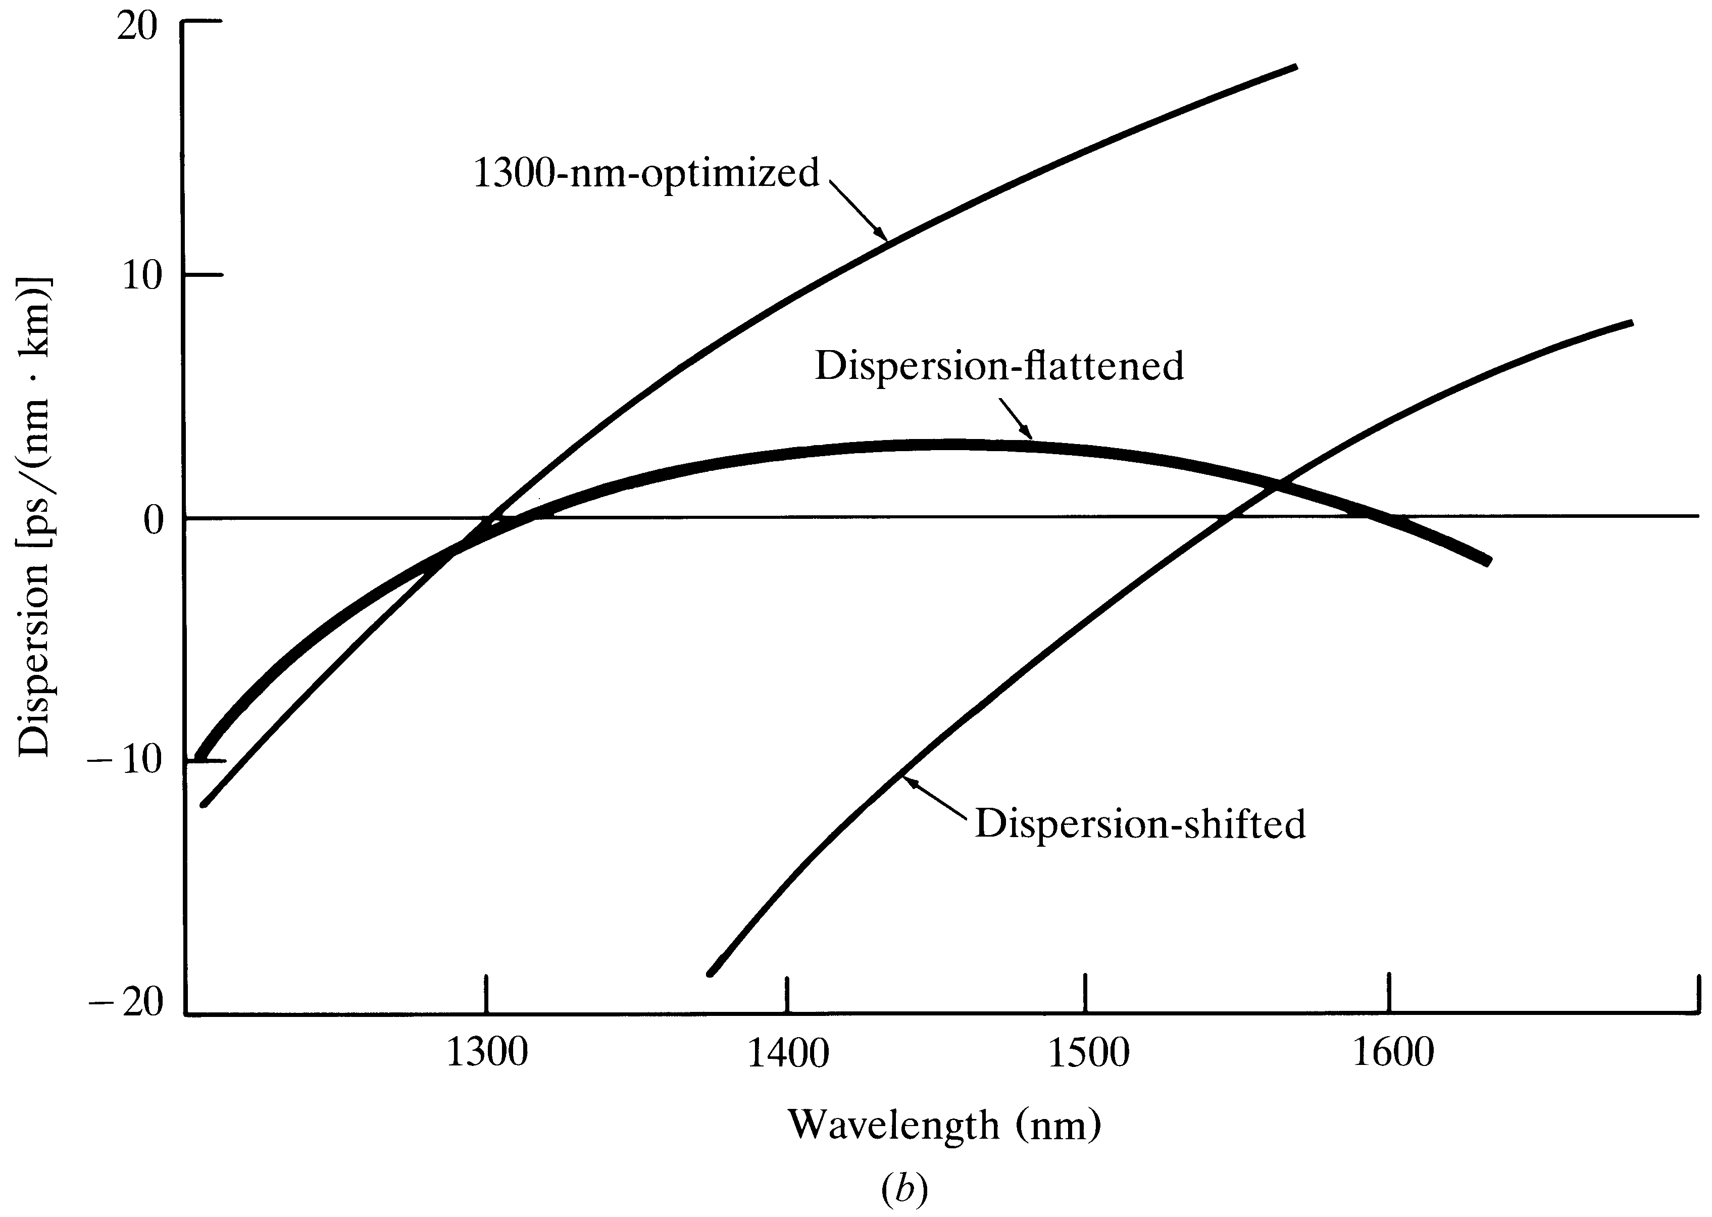
SM-fiber dispersions

Slide 32
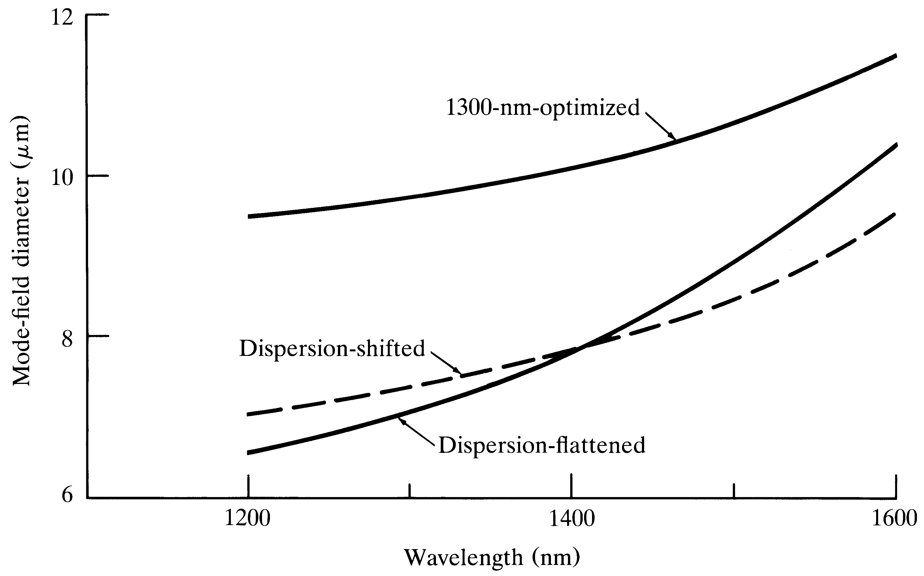
Mode-field diameter vs wavelength

Slide 33
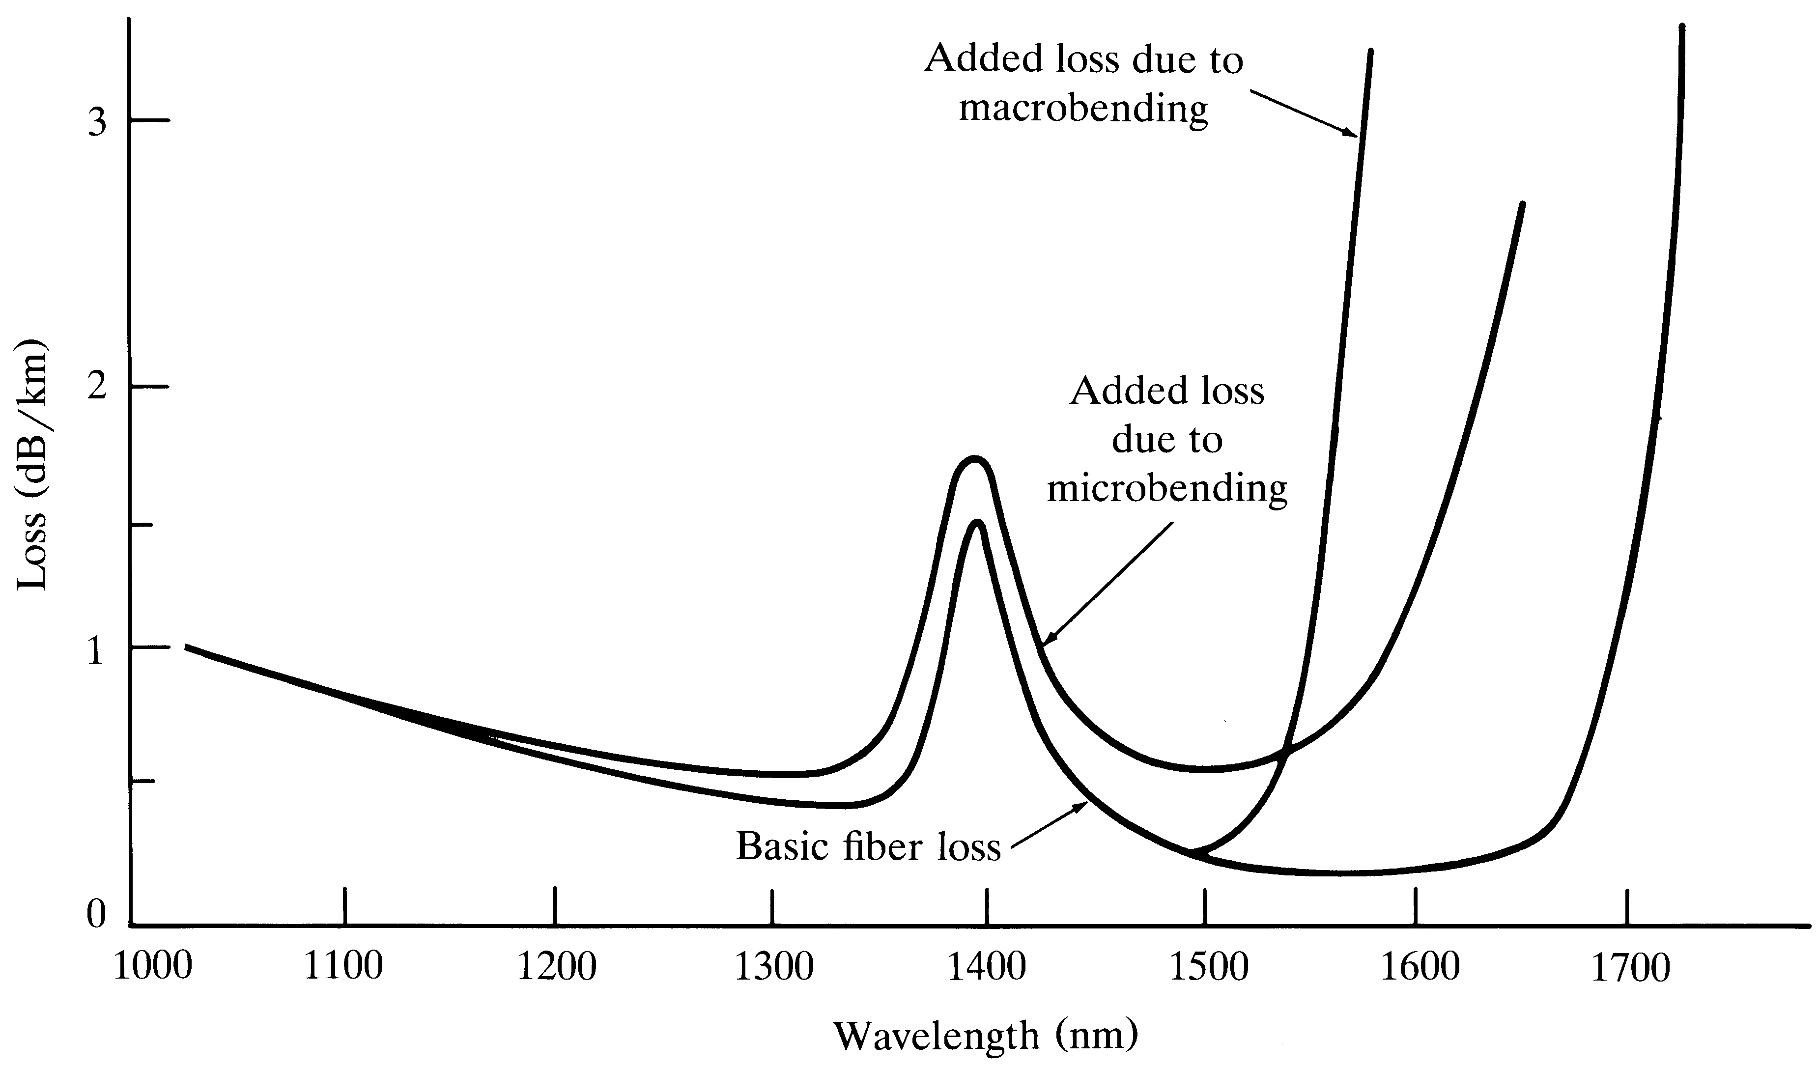
Bending-induced attenuation

Slide 34
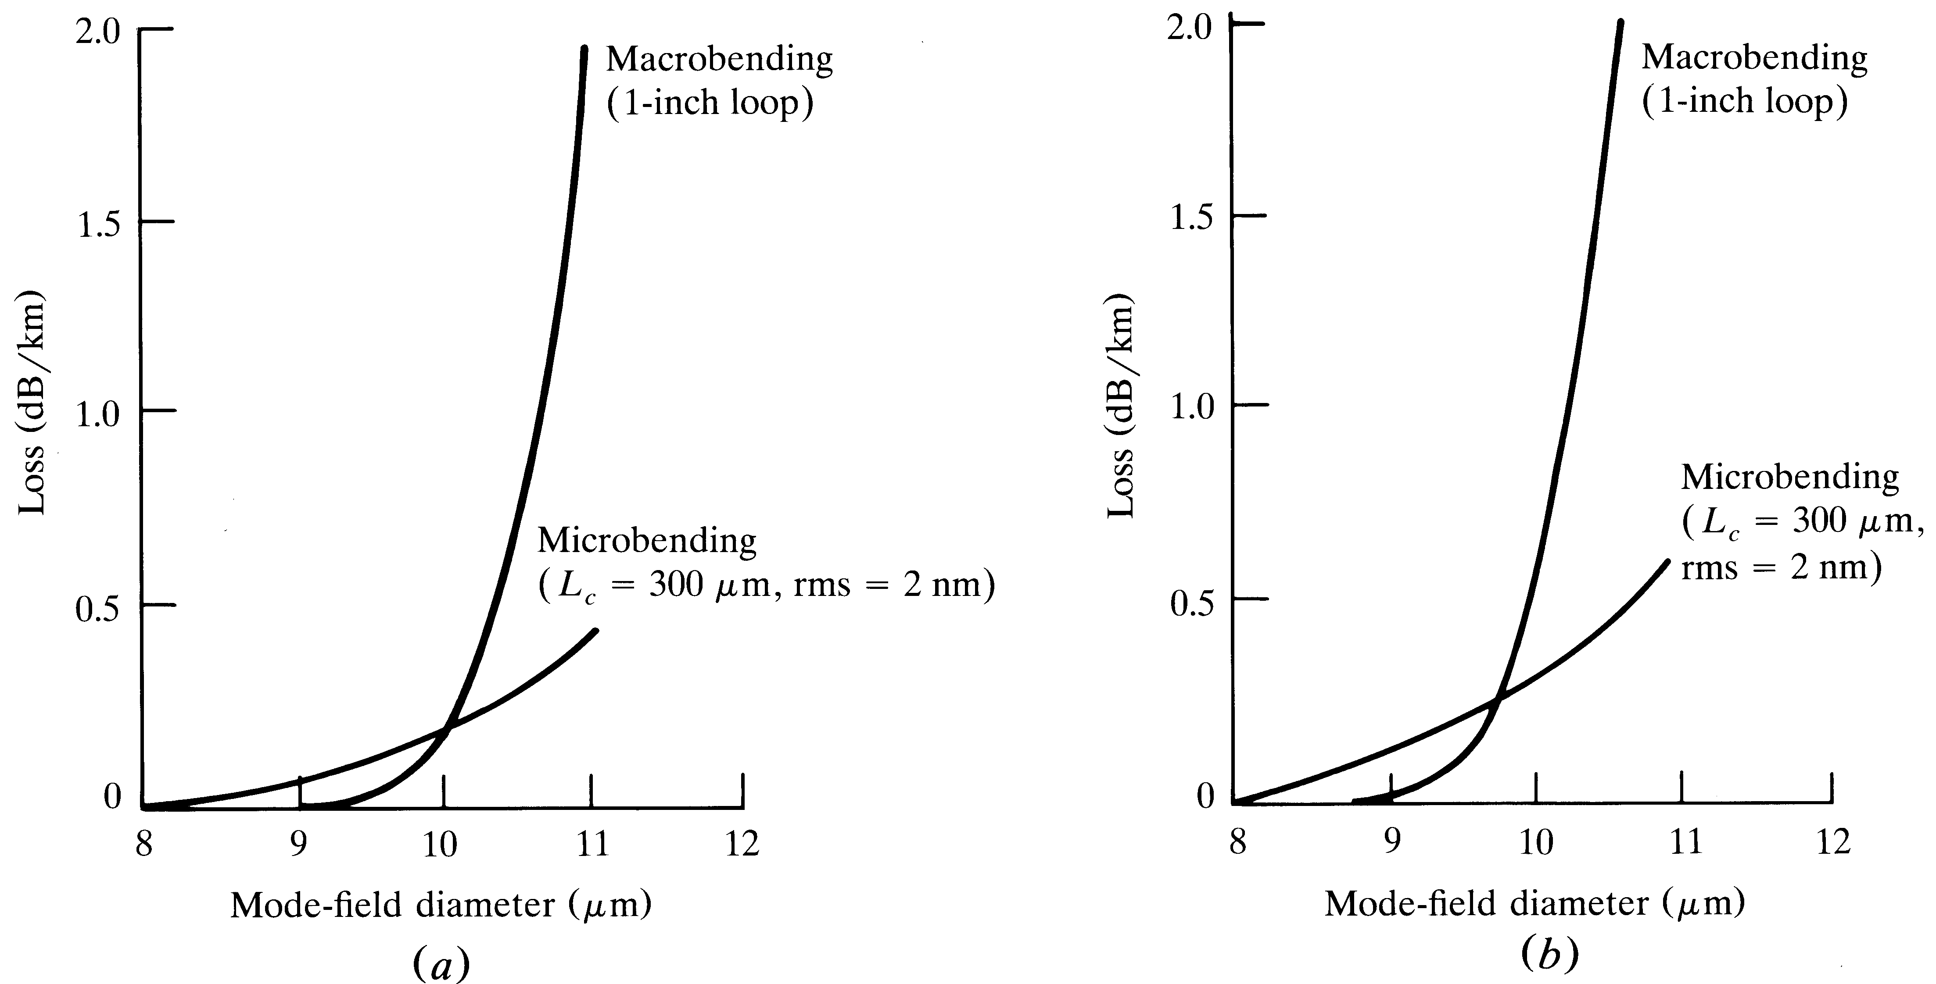
Bending effects on loss vs MFD

Slide 35
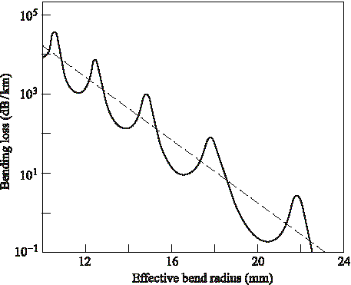
Bend loss versus bend radius

Slide 36
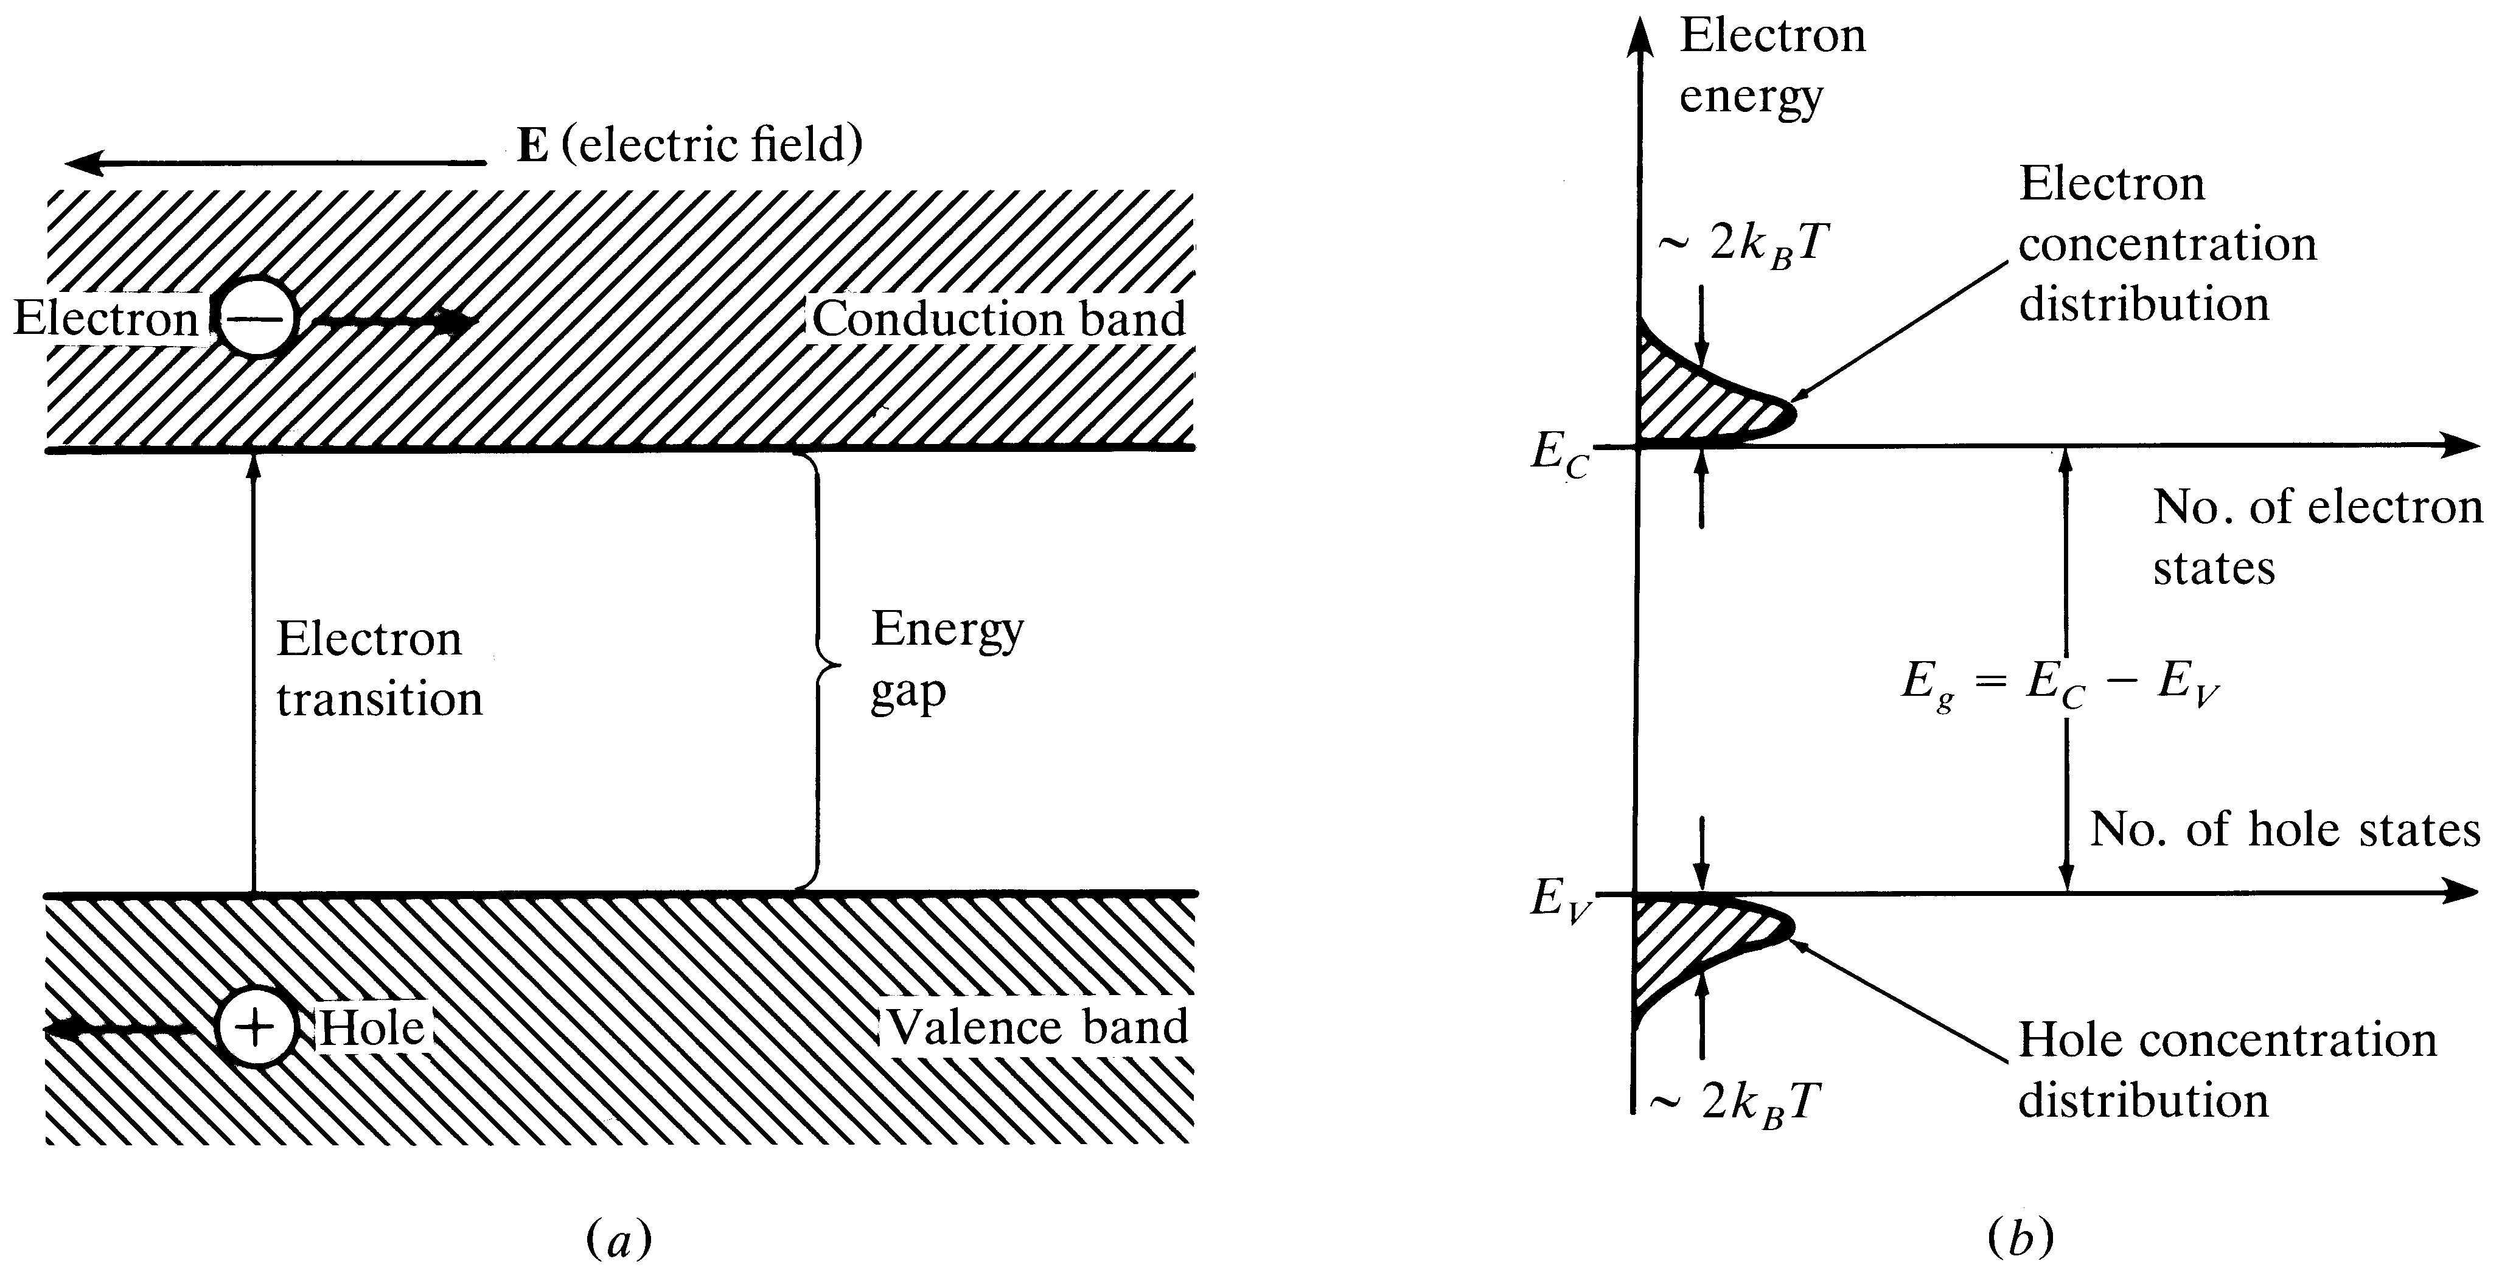
Pure-crystal energy-band diagram
Notes:
1

Slide 37
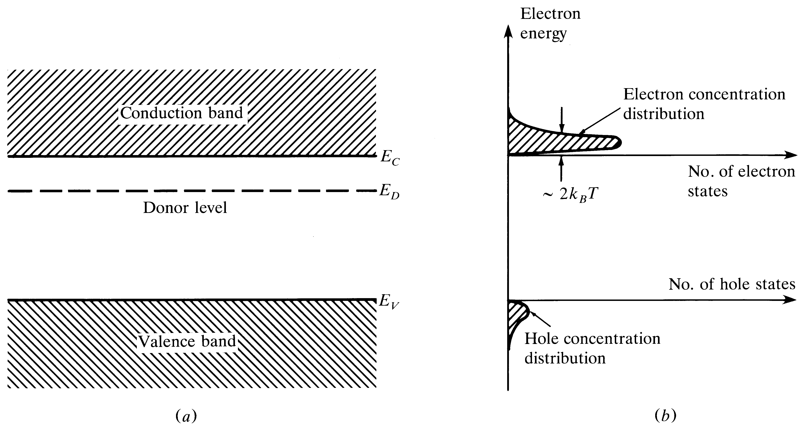
n-type material
Notes:
2

Slide 38
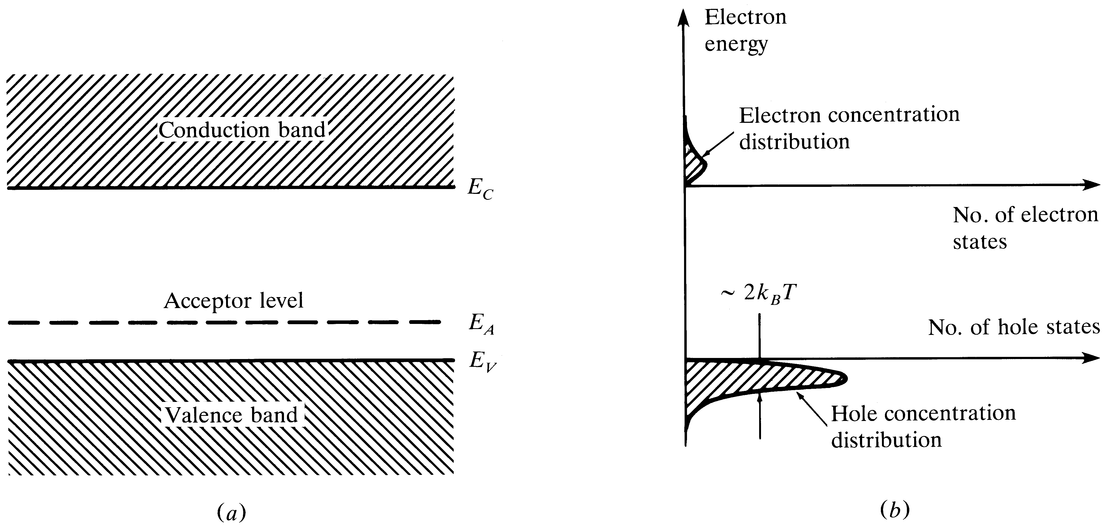
p-type material
Notes:
3

Slide 39
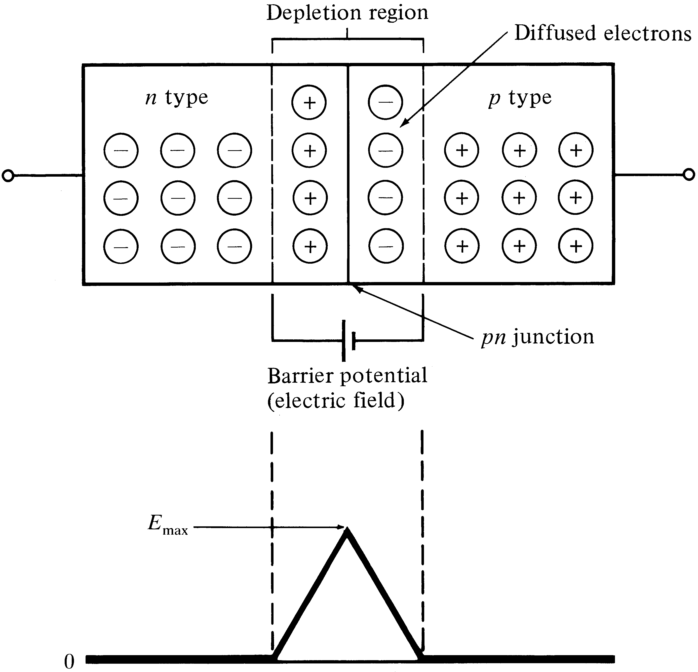
Electron diffusion across a pn junction
Notes:
4

Slide 40
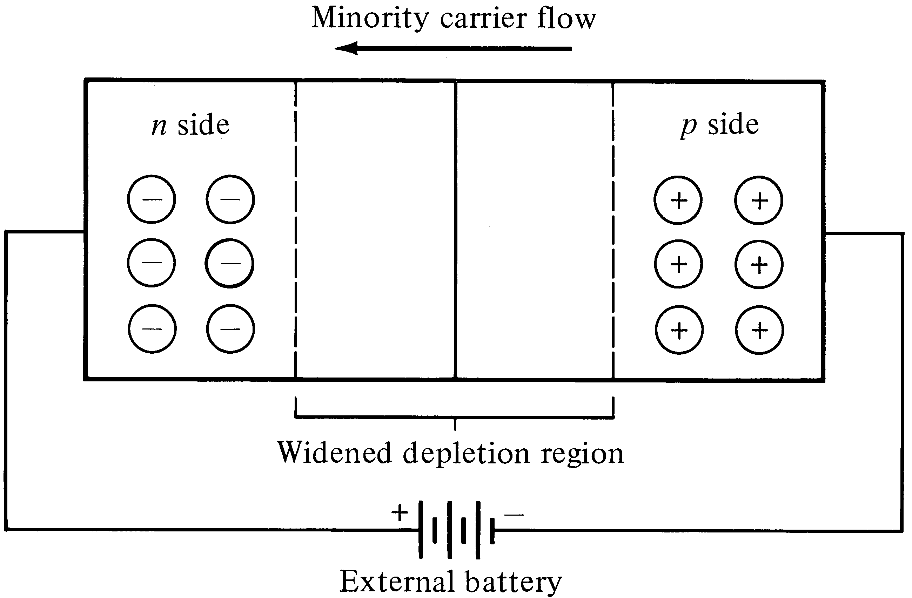
Reverse bias condition
Notes:
5

Slide 41
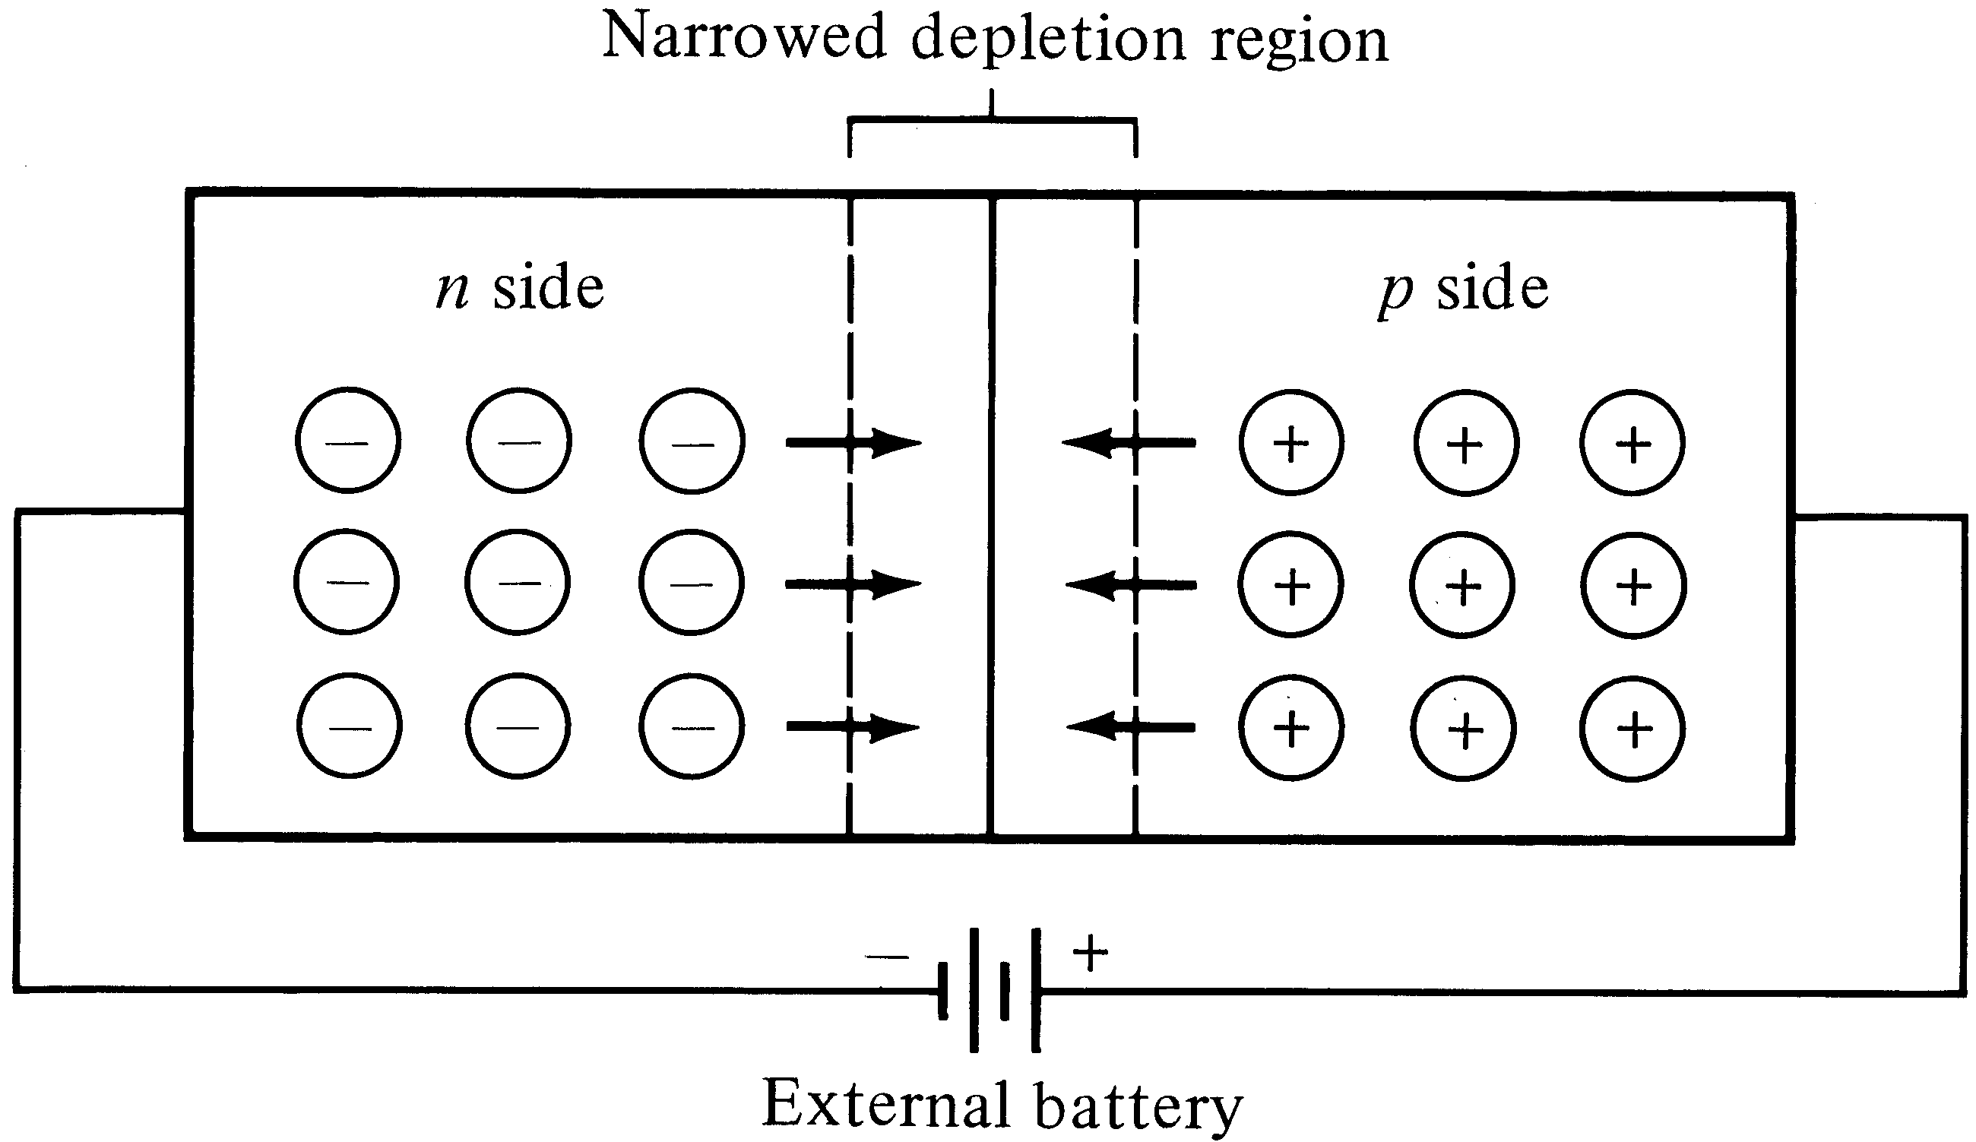
Forward bias condition
Notes:
6

Slide 42
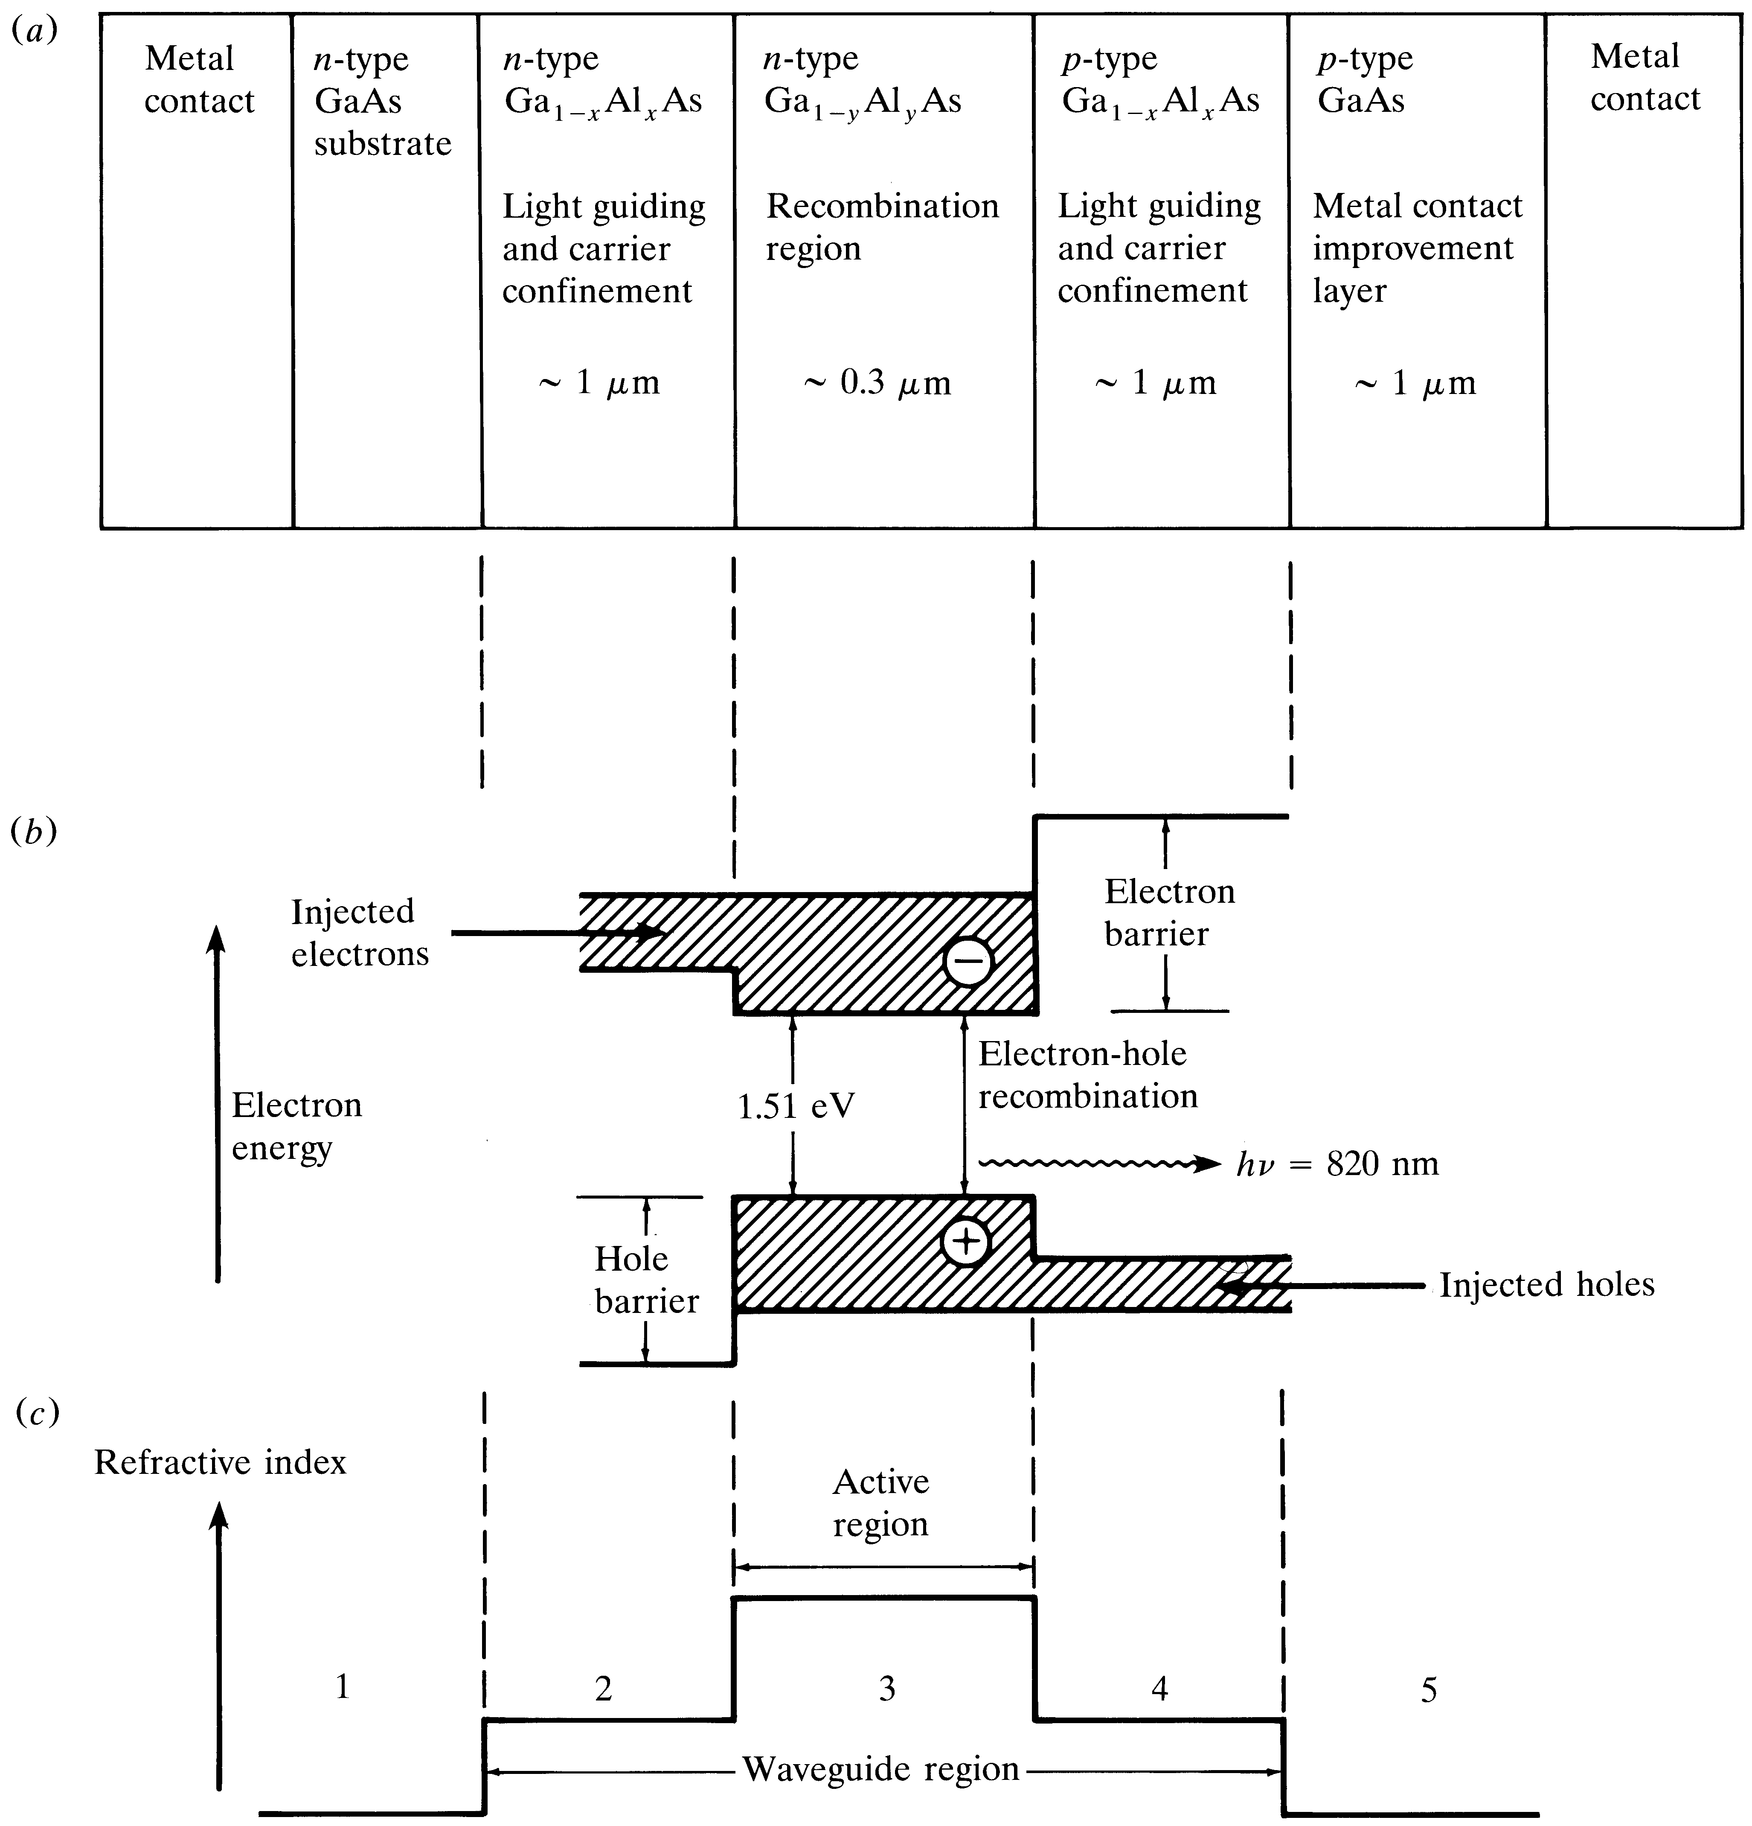
Double-heterostructure configuration

Slide 43
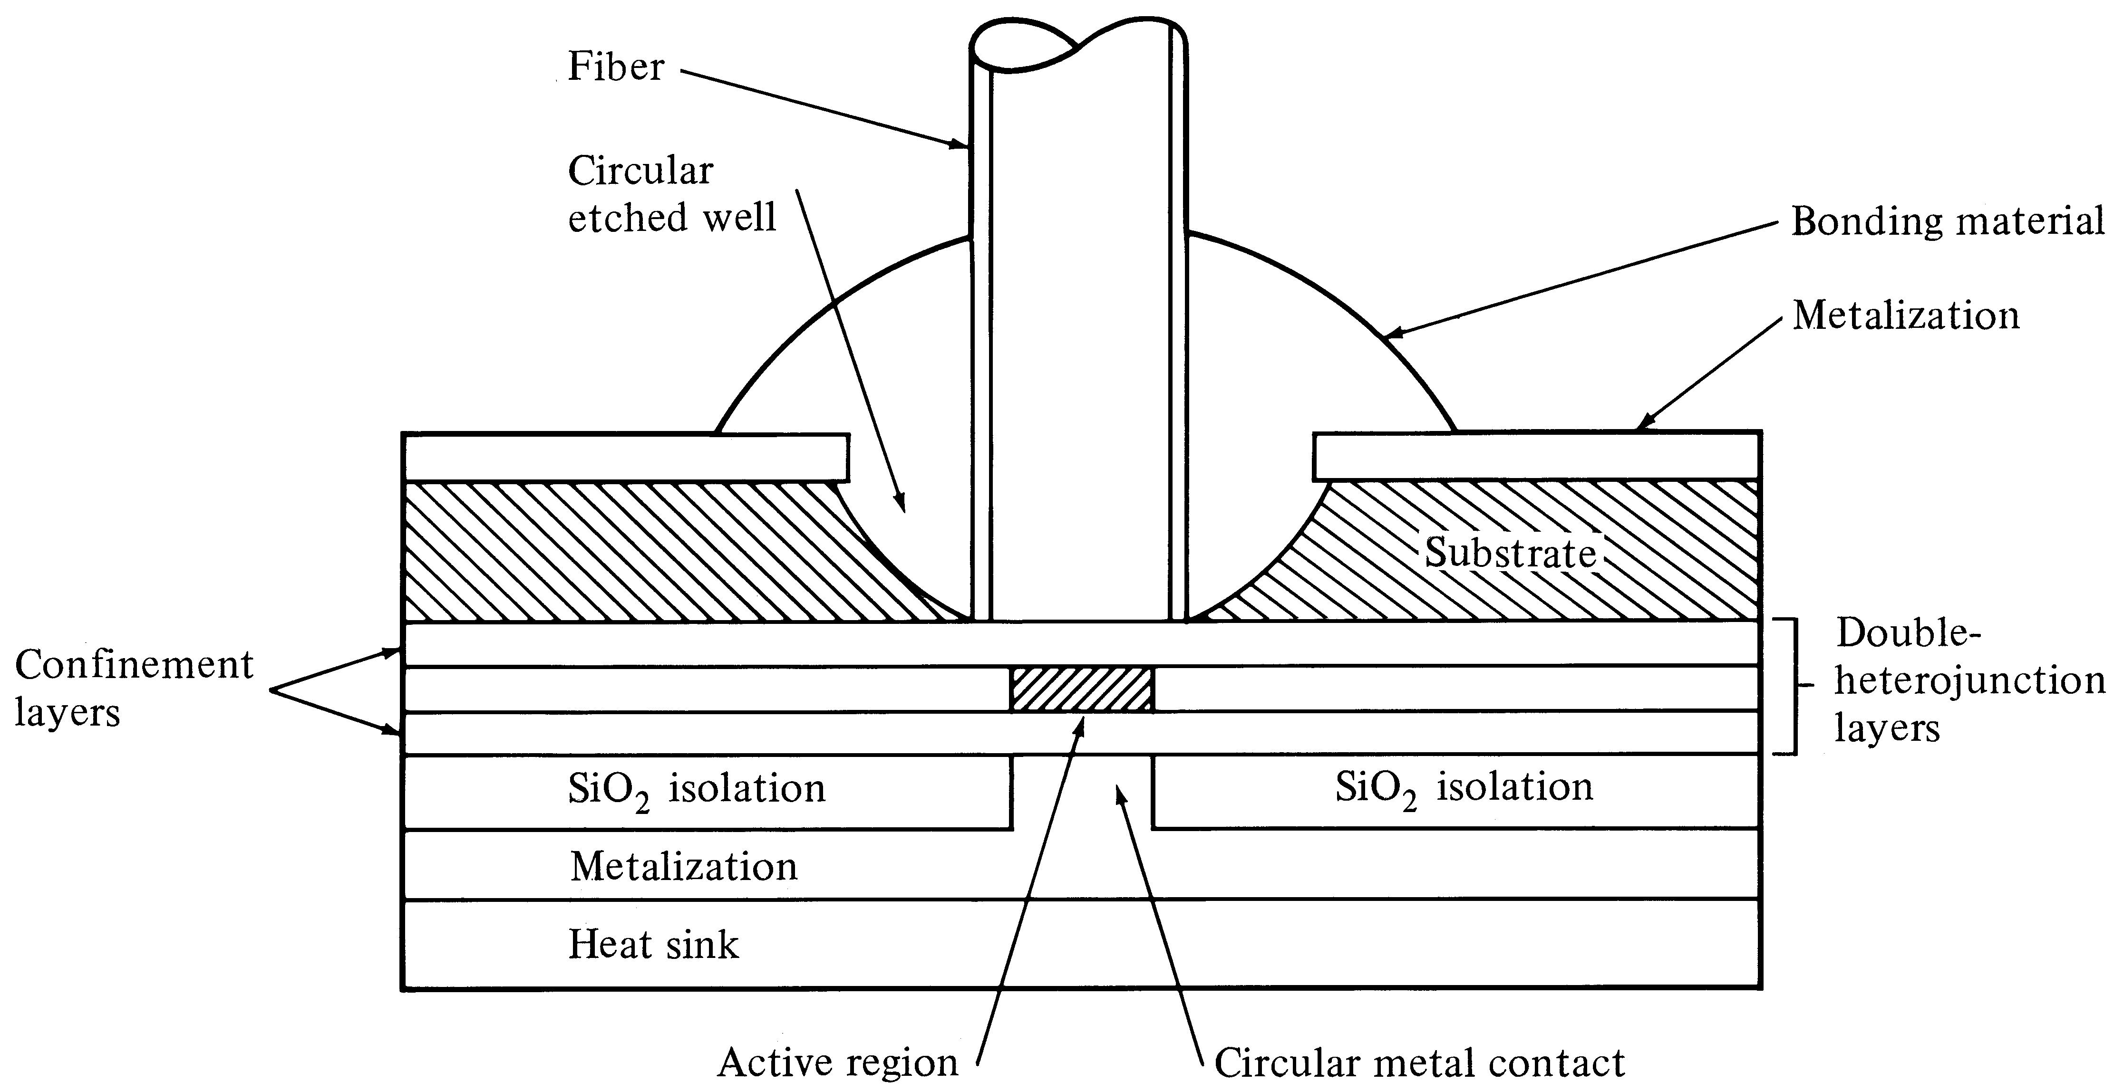
Surface-emitting LED

Slide 44
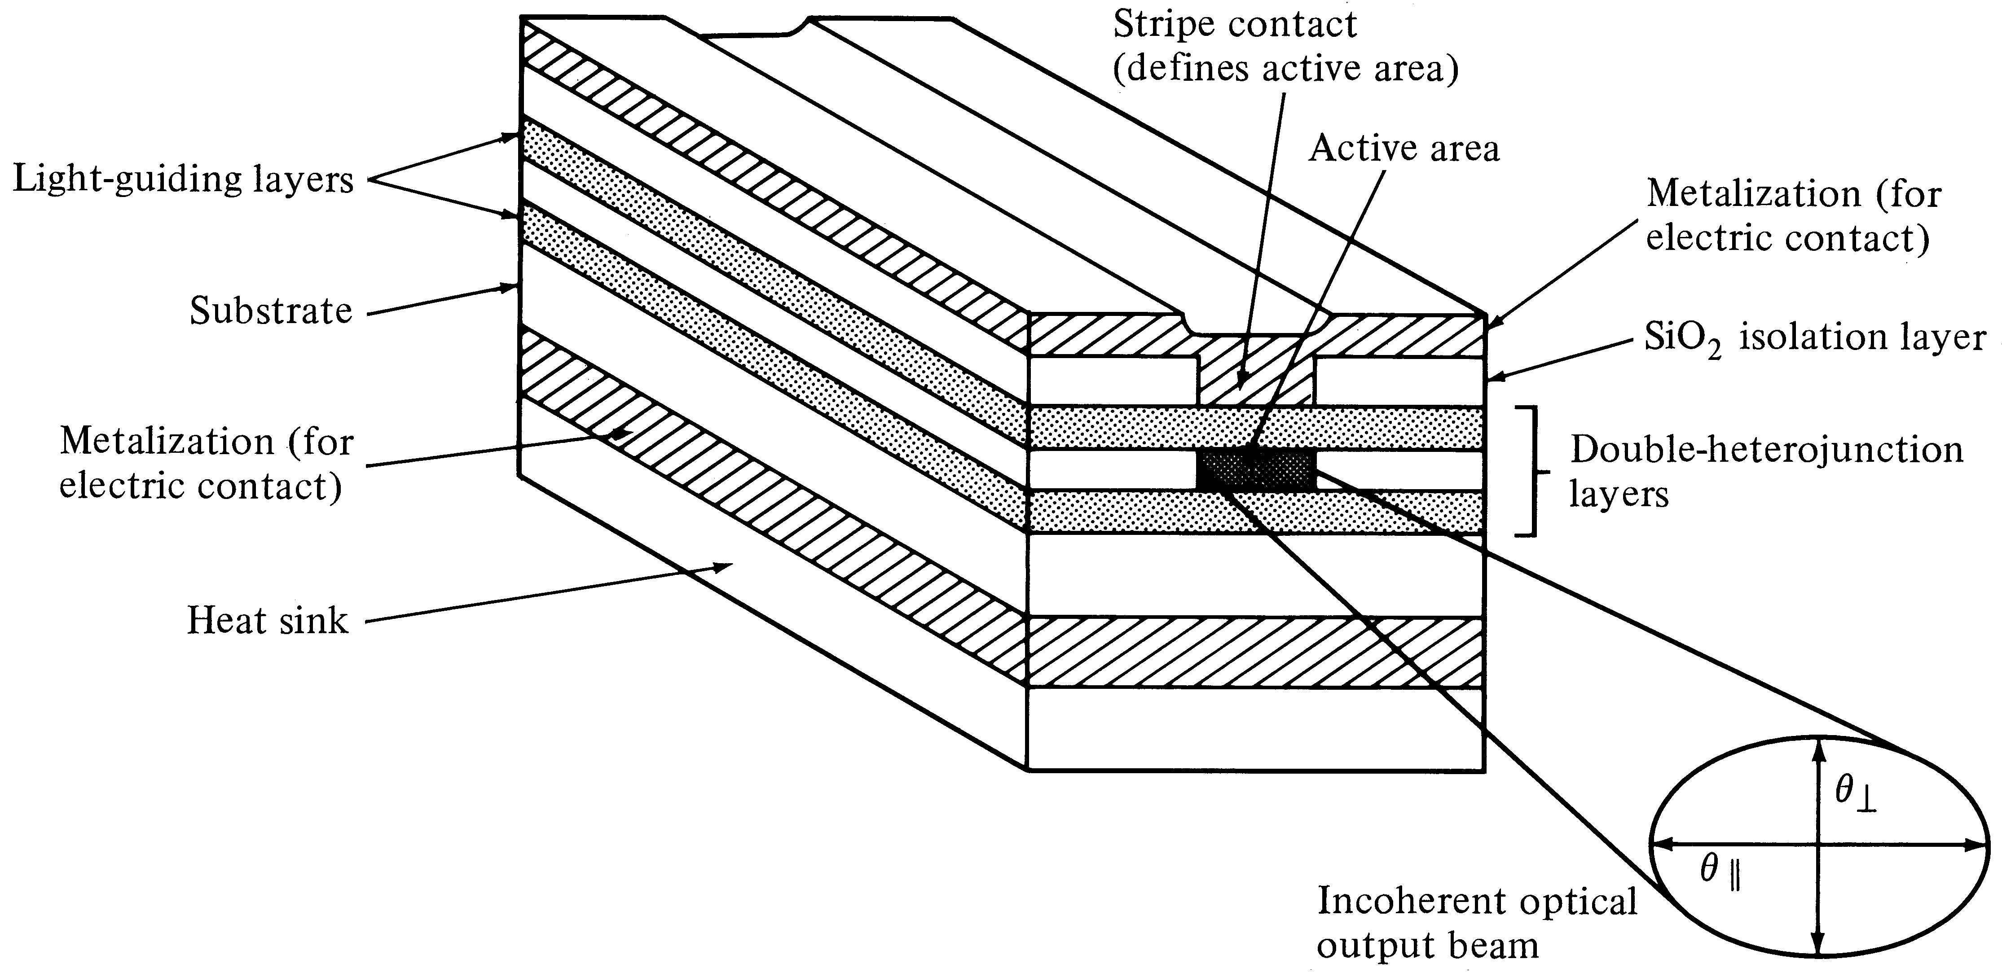
Edge-emitting LED

Slide 45
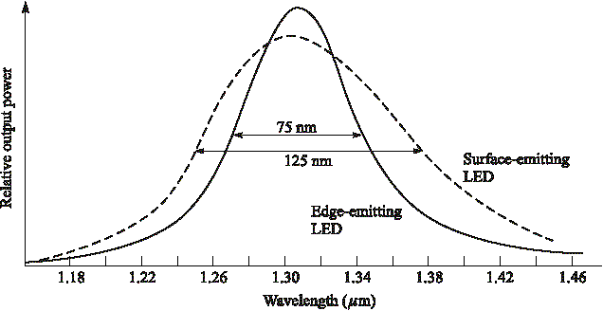
LED spectral patterns

Slide 46
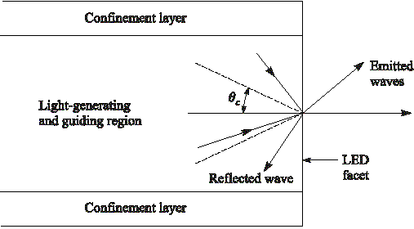
Light-emission cone

Slide 47
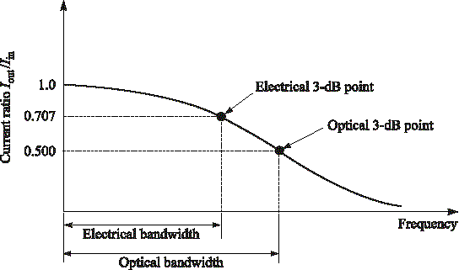
3-dB bandwidth points

Slide 48
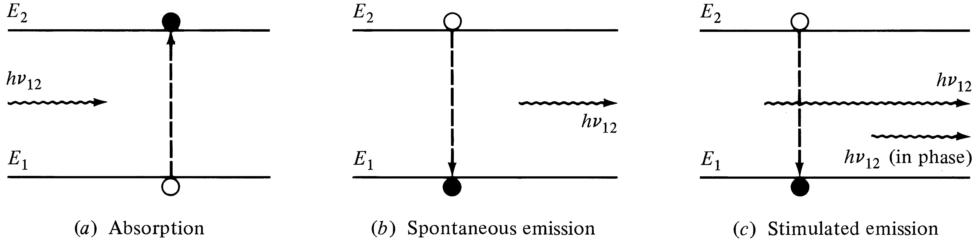
Laser transition processes

Slide 49
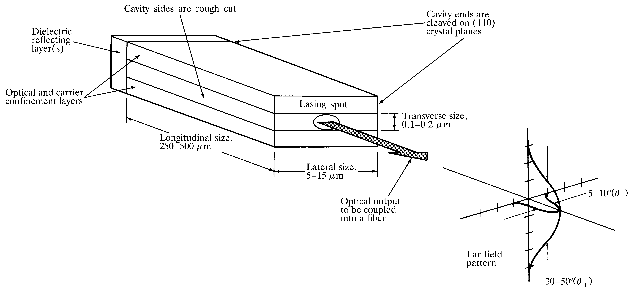
Fabry-Perot resonator cavity

Slide 50
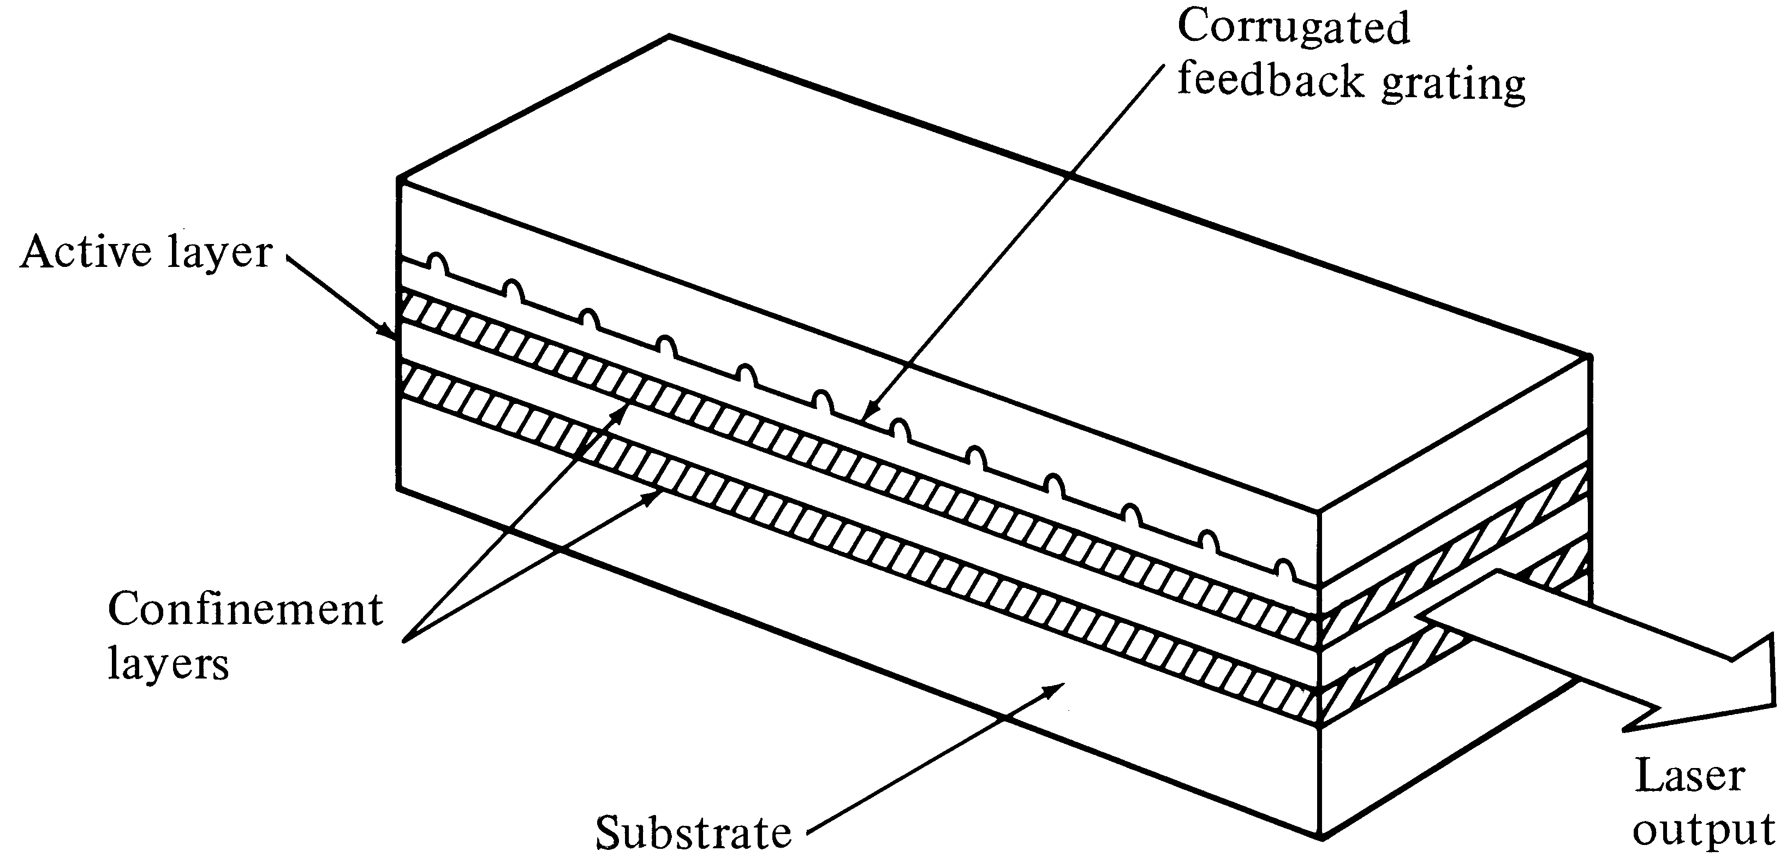
DFB laser

Slide 51

Optical output vs. drive current

Slide 52

Fabry-Perot laser spectrum

Slide 53

Relaxation oscillation peak

Slide 54

Temperature dependence

Slide 55

Modulation methods

Slide 56

Speckle patterns

Slide 57

Time-resolved laser spectra

Slide 58

Emission-pattern coordinate system
Notes:
1

Slide 59

Lambertian radiance pattern
Notes:
2

Slide 60

Source-to-fiber coupling
Notes:
3

Slide 61

Two modal distributions
Notes:
4

Slide 62

Mechanical misalignments
Notes:
5

Slide 63

Axial offset condition
Notes:
6

Slide 64

Longitudinal offset effect
Notes:
7

Slide 65

Comparison of misalignment effects
Notes:
8

Slide 66

Fiber cleaving
Notes:
9

Slide 67

Fiber end defects

Slide 68

Fusion splicing

Slide 69

End face reflections

Slide 70

Angled end face

Slide 71

Signal path through an optical link
Notes:
1

Slide 72

Noise sources and disturbances
Notes:
2

Slide 73

Pulse spreading
Notes:
3

Slide 74

Optical receiver schematic
Notes:
4

Slide 75

Logic 0 and 1 probability distributions
Notes:
5

Slide 76

Noise variances
Notes:
6

Slide 77

BER versus Q factor
Notes:
7

Slide 78
BER vs SNR
Notes:
8

Slide 79

Analog LED modulation
Notes:
9

Slide 80
Simple point-to-point link
Notes:
1

Slide 81

Optical power-loss model
Notes:
2

Slide 82

Receiver sensitivities vs bit rate
Notes:
3

Slide 83

Example link-loss budget
Notes:
4

Slide 84

Transmission distance vs data rate
Notes:
5

Slide 85

Transmission distance vs data rate
Notes:
6

Slide 86

NRZ-L data pattern

Slide 87

Baseline wander

Slide 88

RZ data formats

Slide 89

FEC characteristics

Slide 90

Modal noise at a connection

Slide 91
Dynamic spectra of a laser

Slide 92

Mode-partition-noise effects

Slide 93

Chirping & extinction-ratio penalties

Slide 94

Multiple-reflection effects

Slide 95
Simple point-to-point link
Notes:
1

Slide 96
Optical power-loss model
Notes:
2

Slide 97
Receiver sensitivities vs bit rate
Notes:
3

Slide 98
Example link-loss budget
Notes:
4

Slide 99
Transmission distance vs data rate
Notes:
5

Slide 100
Transmission distance vs data rate
Notes:
6

Slide 101
NRZ-L data pattern

Slide 102
Baseline wander

Slide 103
RZ data formats

Slide 104
FEC characteristics

Slide 105
Modal noise at a connection

Slide 106
Dynamic spectra of a laser

Slide 107
Mode-partition-noise effects

Slide 108
Chirping & extinction-ratio penalties

Slide 109
Multiple-reflection effects

Slide 110


Slide 111


Slide 112


Slide 113


Slide 114


Slide 115


Slide 116


Slide 117


Slide 118


Slide 119


Slide 120


Slide 121


Slide 122


